Slide 1
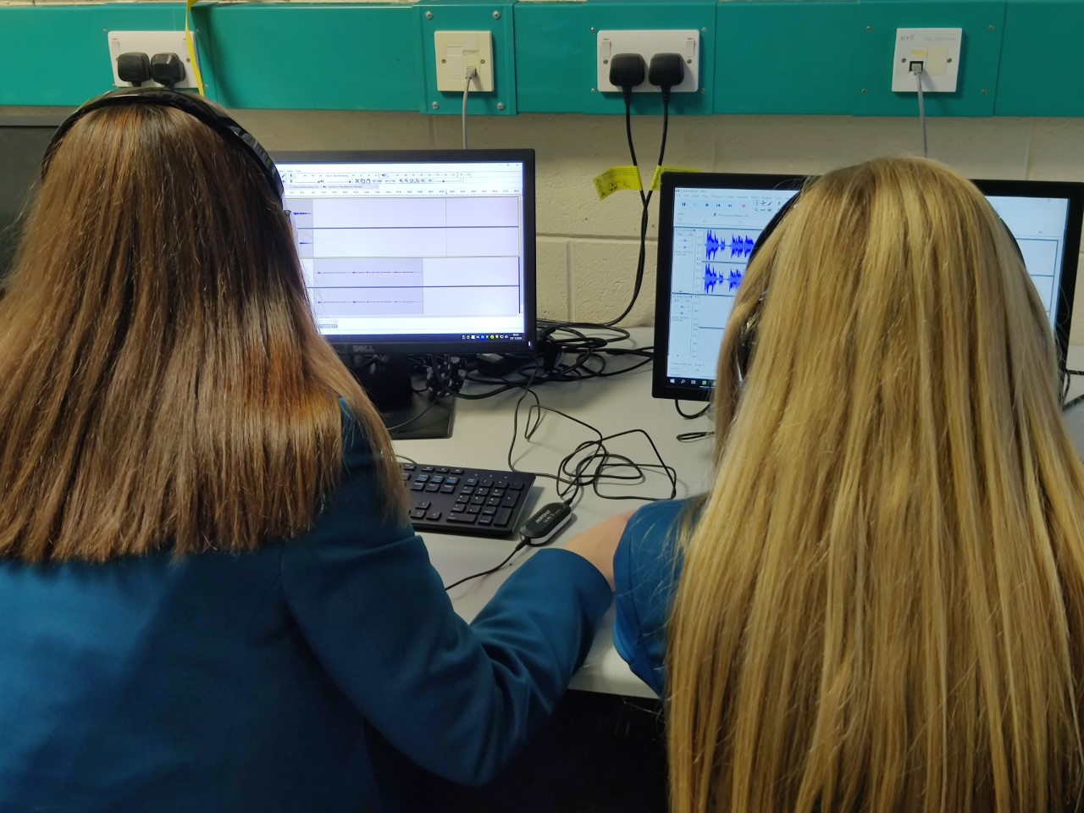
THE OSQ Design and creativity OPTION FOR YEAR 10
Ict DEPARTMENT January 2022

Slide 2
Why study osq – design and creativity?
A qualification in OSQ – Design and Creativity will give you excellent
ICT knowledge, sharp analytical skills and excellent problem-solving skills. This means that when it comes to potential careers, the world is pretty much your oyster. Career prospects in IT are excellent.
The world of work is constantly changing. It is increasingly unlikely that a single occupation will take employees from the beginning to the end of their working lives, so transferability and adaptability are important skills.
This specification is uniquely structured with this in mind. Learners have the opportunity to learn for work, through work and about work, with real outcomes that will give them skills for life.
Occupational Studies can provide a hands-on approach to learning. What makes it different is its focus on particular kinds of knowledge, understanding and skills, providing the potential for learning in important ‘out-of-school’ contexts.

Slide 3
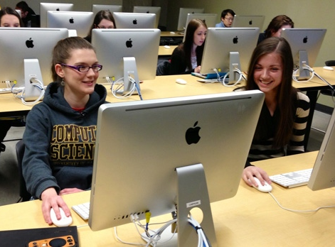
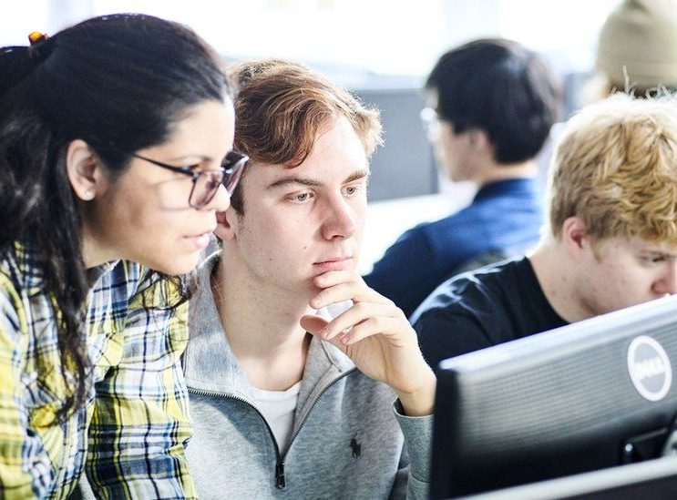
STUDYING COMPUTERS IS NOT JUST FOR BOYS!
There is a false perception that ICT/Digital Technology is a subject more suited toward male students – this could not be further from the truth!
Recently one of our female students achieved an A* in her Digital Technology GCSE course and all 6 female students in last year’s Year 14 A Level class achieved a Distinction* overall (which is the highest grade achievable)!
As a department we are very proud of our results at GCSE and A Level – both girls and boys have performed brilliantly and enjoyed the courses very much!
The number of women taking places on computer courses has more than doubled in recent years. Only 22% of students on computer-related University courses were female just 6 years ago – that number has grown now to over 45% in many cases!

Slide 4
COURSE AIM
Occupational Studies should enable learners to:
develop the knowledge, understanding and skills they need
to undertake work-based tasks;
engage actively in work-based learning within coherent occupational contexts;
reflect on their learning;
develop an appreciation of the progression/career opportunities that exist through the study of Occupational Studies;
develop an appreciation of the environmental impacts of the practical tasks they carry out within occupational contexts; and
develop an awareness of general and specific health and safety issues arising from activities within occupational contexts.

Slide 5
CCEA OSQ DESIGN AND CREATIVITY
To achieve a qualification, learners must take two units from this occupational area
1. Website Development
2. Graphic Design
Feedback from a Past Student
“I loved researching for my own Website – I produced a Website for a local Hair and Beauty Shop– My friend works there and when I completed it, I was able to show the manager who was delighted with the end result! I now provide ICT help and support to this company which means that I update their Website and ensure that all their online marketing is up to date on their Instragram and Facebook page! I have created a Logo as well as hard copy and online magazine and brochures for a range of other companies and love my work”
2.

Slide 6
COURSE CONTENT - YEAR 11 OSQ DESIGN AND CREATIVITY
Website Development
This unit is designed to develop vocational skills in
website development and associated activities. Learners
will develop skills in planning, producing and presenting a website (based on client brief) using industry standard procedures.
You can choose to build a Website for a local company or you can build one for your own company! Many students like to create a Website for a local company which makes it more realistic. Some local companies do not have A Website so this could be an ideal opportunity for you to show them what is possible as well as showcasing your ICT skills!

Slide 7
COURSE CONTENT - YEAR 12 OSQ DESIGN AND CREATIVITY
Graphic Design
This unit is designed to develop skills in graphic design and associated activities. Learners will develop skills in planning, producing, and presenting a graphic design project (based on a client brief) using industry standard procedures.
Examples of topics that could be used for design briefs include events/festivals, health and wellbeing, transport, country or city life, or communication.
Final outcomes can include a brochure, a leaflet, outdoor advertising, an online advert or a colour spread for a magazine or a newspaper.

Slide 8
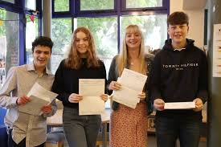
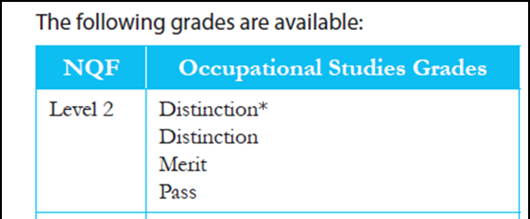
COURSE QUALIFICATIONS

Slide 9
Progression opportunities
This course prepares students for employment in the Digital Technology/ICT area. Examples are - Technician, Computer Programmer, ICT/Digital Technology Teacher, Software/Games Developer etc…
This course also:
Enables progression to further and higher education level and employment
Applies knowledge across a range of ICT/Digital Technology based scenarios
Develops valuable and transferable skills to prepare you for an ever changing and dynamic work place
Students can further their study in Sixth Form by completing:
OCR Cambridge Technicals in ICT

Slide 10
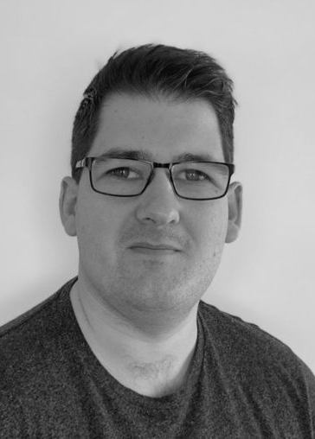
PAST ICT/DIGITAL TECHNOLOGY PUPIL SUCCESSES
Dominic Holmes completed his GCSEs and 6th form here at North Coast Integrated College. He loved studying ICT and it was among his favourite subjects.
He went on to study Computing with Game Development at Ulster University where he graduated with a first-class Honours degree. He was encouraged to pursue further education and applied for a PhD at Ulster University which focused on how to apply computer technology to healthcare, particularly for the rehabilitation of people who have suffered a stroke. He completed his PhD in 2018 and continues today to conduct research for Ulster University related to healthcare technologies. From his research, he co-founded and is currently CTO of eXRT Intelligent Healthcare, which delivers healthcare products to improve patient mobility and healthcare practices. eXRt’s current product provides stroke patients with a fun way of performing their physiotherapy at home using virtual reality devices; their physiotherapist can remotely monitor their progress from a mobile app in real-time.
This product has been used in research with the NHS, Italian and Norwegian hospitals , with more plans to expand across UK/Europe. The company is still in start-up phase and is involved in several investor funding events such as INVENT2020 by Catalyst in Belfast. It was just announced recently that the company is a finalist in the competition.
One of the company employees is also a past pupil of NCIC student, Roisin Holmes who graduated from Ulster University with a first-class Honours degree in Computing. She has been working on the development of the product and plays an important role in social media and marketing of the product.

Slide 11
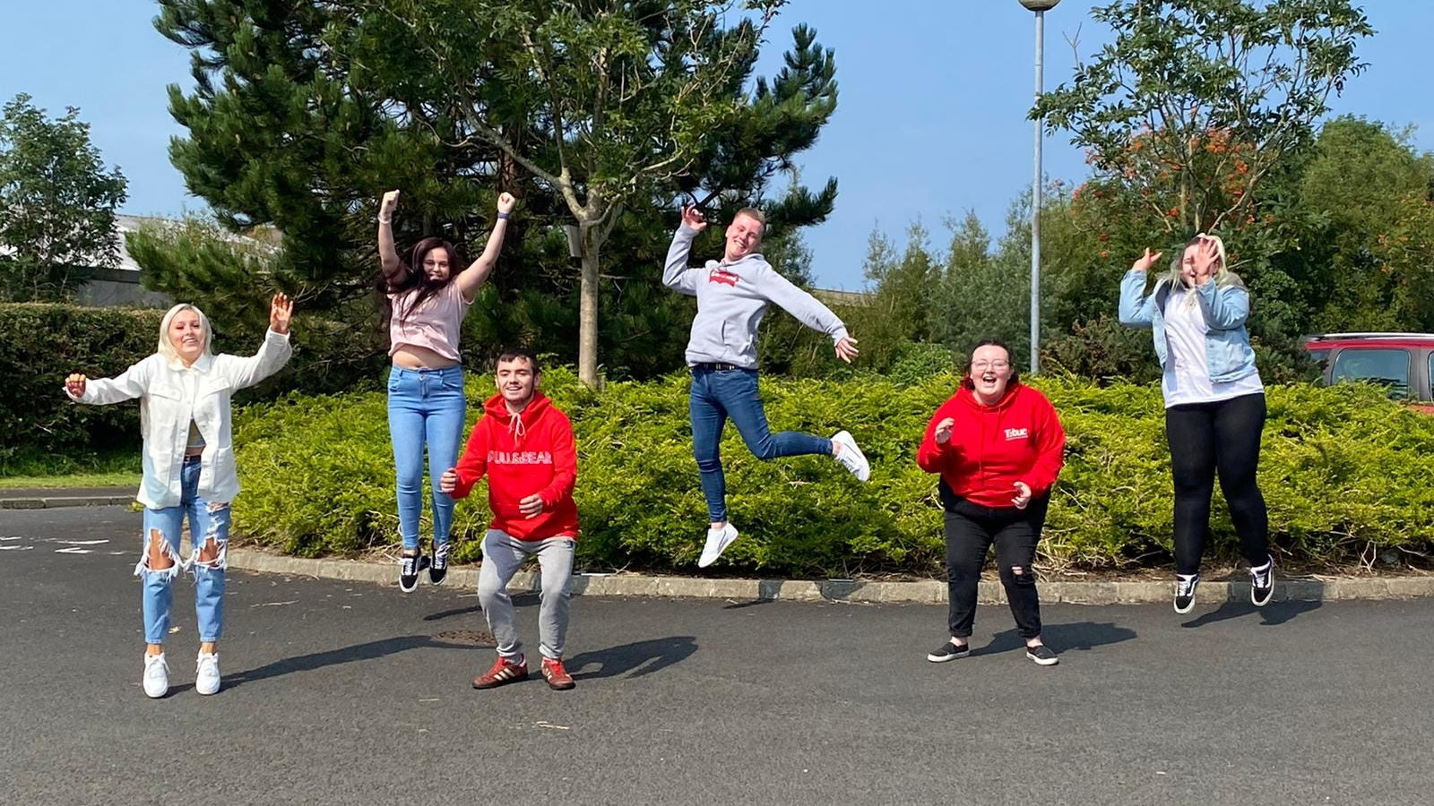
By choosing OSQ DESIGN AND CREATIVITY you are:
Choosing a modern qualification lots of employers want skills in
Working in a department with a great track record of exam success
Getting to work in modern and well-equipped computer labs
Opening up many career paths that lead to well-paid jobs
Studying a subject that is challenging, enjoying and fitting for the modern world

Slide 12
Any further questions?
Please feel free to send an email message to Mrs Shaw rshaw387@c2ken.net, Mr Moran gmoran263@c2ken.net or Mrs Tasker dtasker929@c2ken.net with any questions you have about your options and the OSQ DESIGN AND CREATIVITY course. Or feel free to call in to talk to these teachers who will be delighted to hear from you

