Slide 1
BUSINESS STUDIES OPTION FOR SIXTH FORM
BUSINESS DEPARTMENT January 2022
Press F5 for automatic presentation and audio commentary

Slide 2
COURSE AIM
OCR CAMBRIDGE TECHNICALS BUSINESS EXTENDED COURSE
Business covers a broad range of fields, including retail, human resources, finance, law, sales, marketing and administration. Students have the opportunity to study the importance of Business and Communication Systems which contribute to the success of a business. Be introduced to the various aspects of the world of business. Students will:
Acquire useful practical skills in a wide range of areas.
Develop both practical and analytical business skills
Develop skills which lead to a number of career paths e.g. finance, business, IT, teaching and many, many more!

Slide 3
Who should study Business Studies?
Can anyone do business studies?
No prior attainment is required to study this course. You should be a person who is interested in the business world and keen to learn how top entrepreneurs have succeeded in their chosen fields.
Progression Opportunities
University courses (full UCAS points equivalent to an A Level
Employment opportunities involving need for business knowledge and skills
Apprenticeships

Slide 4
COURSE CONTENT - YEAR 13 CAMBRIDGE TECHNICALS BUSINESS EXTENDED CERTIFICATE
Unit 1 – the Business Environment (Double Exam Unit)
Unit 4 – Customers and communication
(Coursework)

Slide 5
COURSE CONTENT - YEAR 14 CAMBRIDGE TECHNICALS BUSINESS EXTENDED CERTIFICATE
Unit 2 – Working in business (exam)
Unit 5 – Marketing and Market Research
(coursework)
Unit 17 – Responsible Business Practices (coursework)

Slide 6
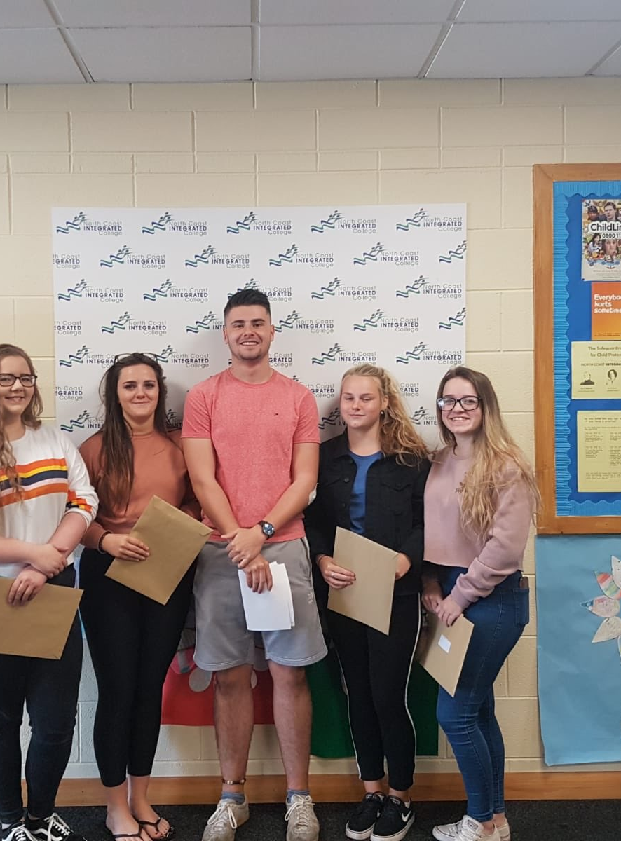
By choosing Business Studies you are:
Choosing a modern qualification lots of employers want skills in
Gaining UCAS points the equivalent to a full A Level
Getting to work in modern and well-equipped computer labs
Opening up many career paths that lead to well-paid jobs
Developing lots of computer-based skills
Studying a subject that is challenging, enjoying and fitting for the modern world

Slide 7
Careers that a qualification in Business Studies can lead to
Bank manager
Business analyst
Business development manager
Business project manager
Customer services manager
Digital marketer
Estate Agent
Financial Adviser
Human Resources Officer
Investment Analyst
Management Consultant
Market Researcher
Public Relations Officer
Retail Buyer
Retail Merchandiser
Road Transport Manager
Sales Manager
Social Media Manager

Slide 8
Any further questions?
Please feel free to send an email message to Mr Moran gmoran263@c2ken.net or Mrs Shaw rshaw387@c2ken.net with any questions you have about your options and the OCR Cambridge Technicals Business Extended course
Or feel free to call in to talk to these teachers who will be delighted to hear from you

