Slide 1
GCSE Options
Child Development

Slide 2
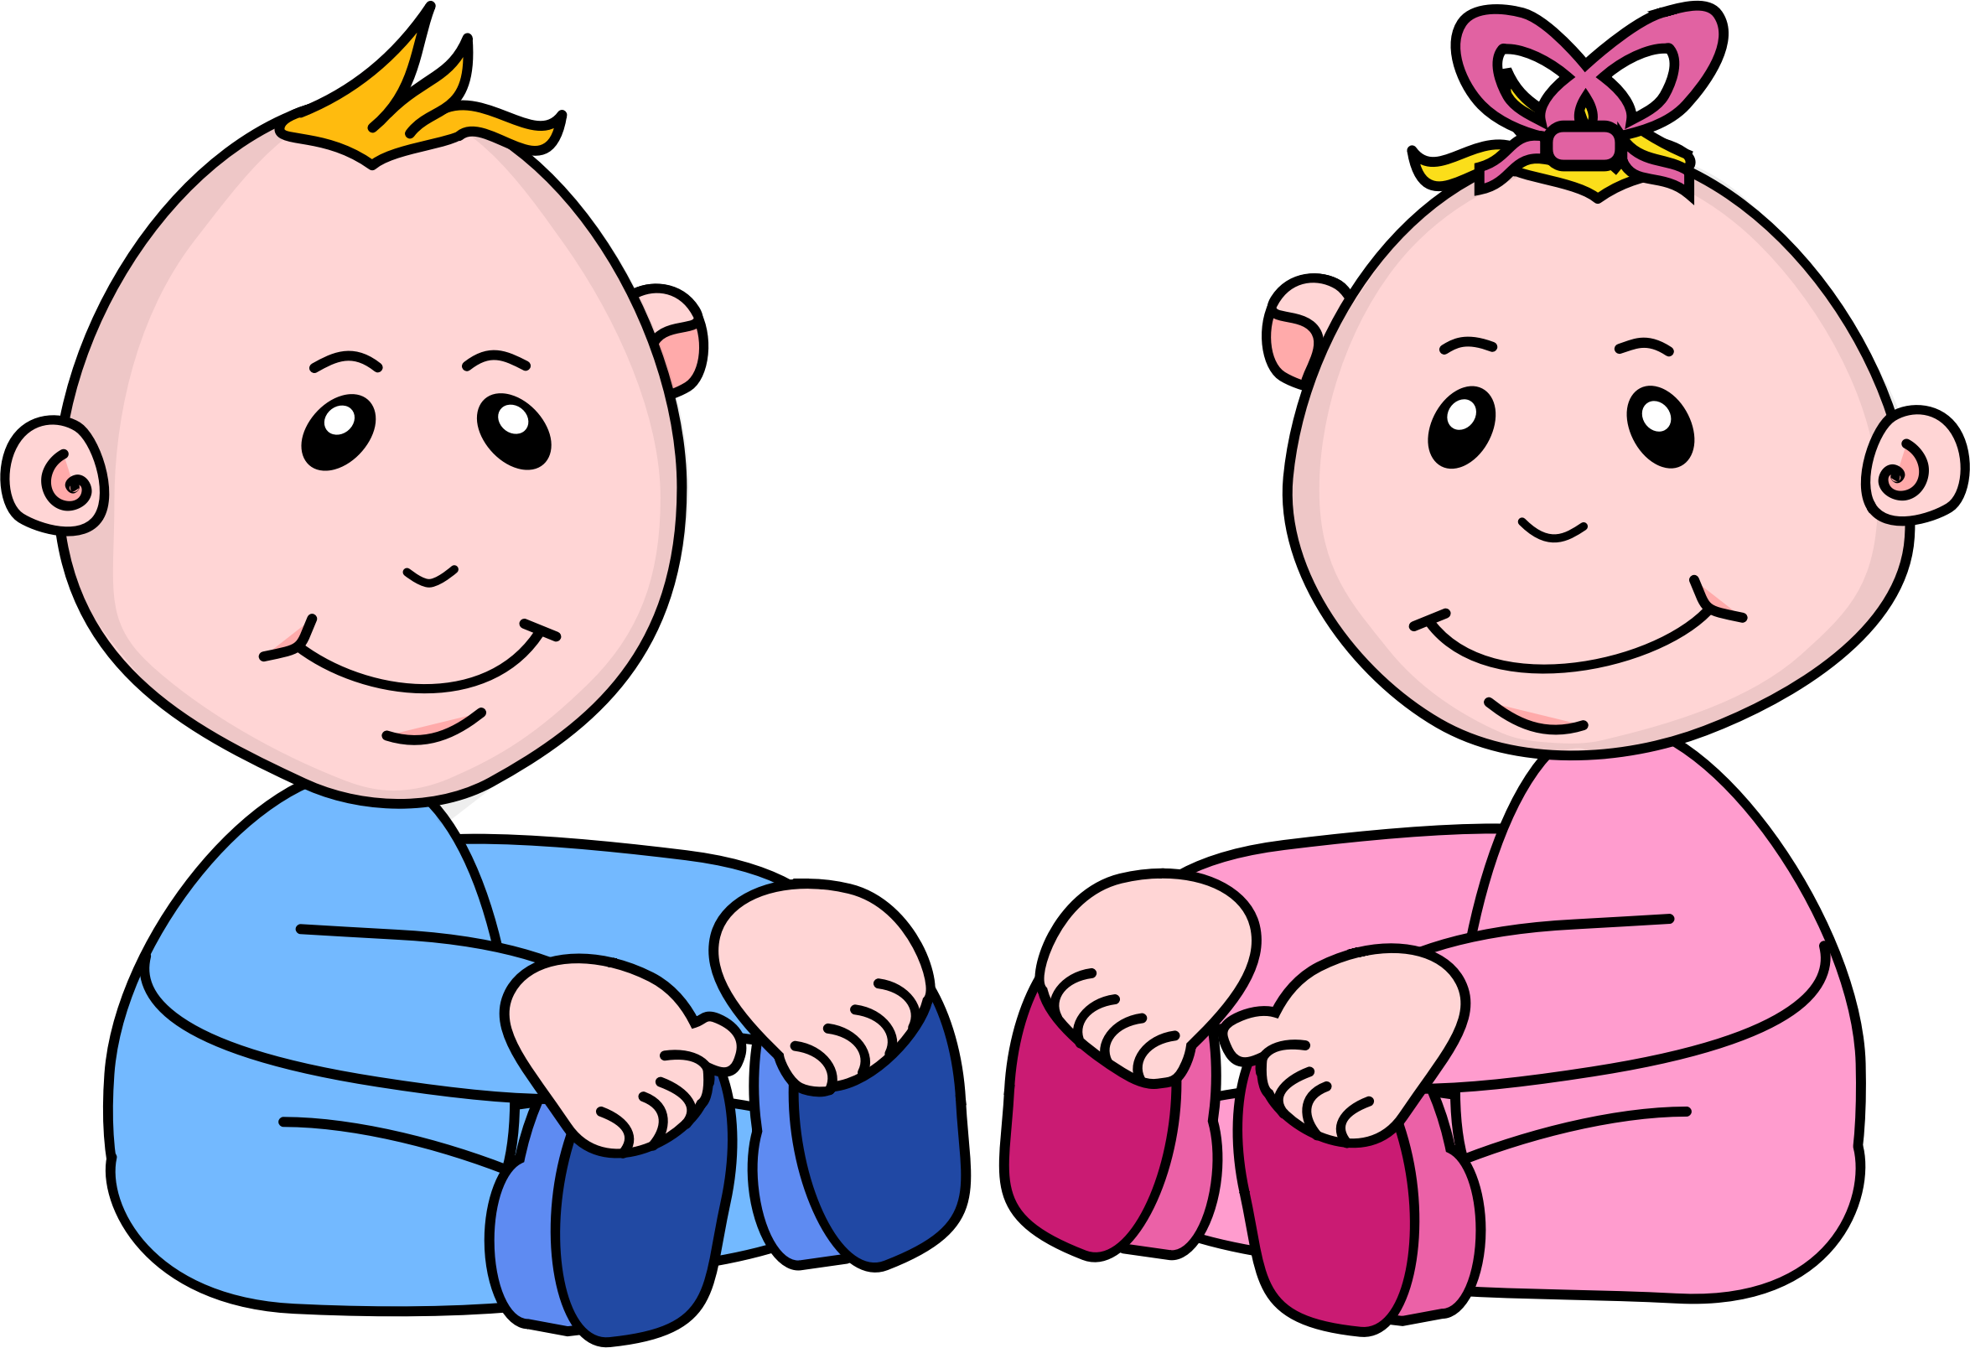
GCSE Child Development- why choose it?
Child Development is a two year course and it focuses on the study of the physical, social, intellectual and emotional development of young children from conception to the age of five years.
If you love babies and children and want to pursue a career involving children then this is the course for you!

Slide 3
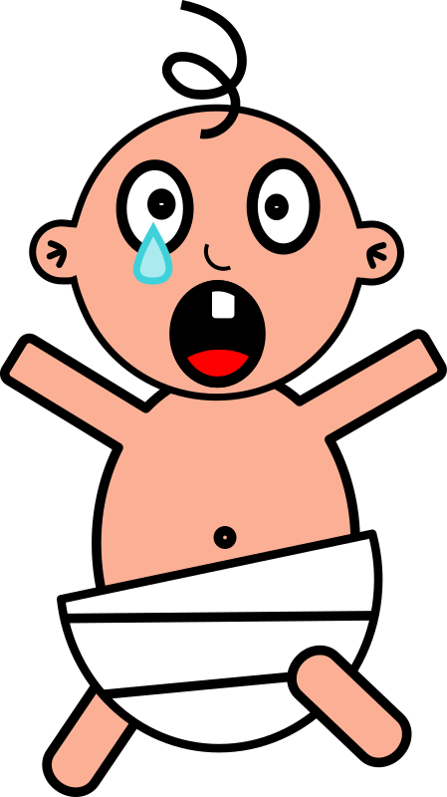
How am I assessed?
Content | Assessment | Weighting (how much is it worth?) | When can I complete this?
Parenthood, Pregnancy and the new born baby | 1 exam paper 1hr 15 mins | 30% | Every Summer
The development of the child (0-5 years) | 1 exam paper 1hr 15 mins | 30% | Every Summer
Controlled Assessment Task Investigative task | One controlled assessment task | 40% | Every Summer

Slide 4
Careers linked to Child Development
paediatrician
Nursery teacher/assistant
Registered child minder
Nurse
Midwife
Paediatrician
Teacher
Classroom assistant
Health visitor
Social worker
dietician

Slide 5
Further information
If you have any questions about the subjects discussed in this presentation, please email Ms Evans at:
levans326@c2ken.net
Or alternatively ring the college on 02870329026 and I can answer any questions you may have

