Slide 1
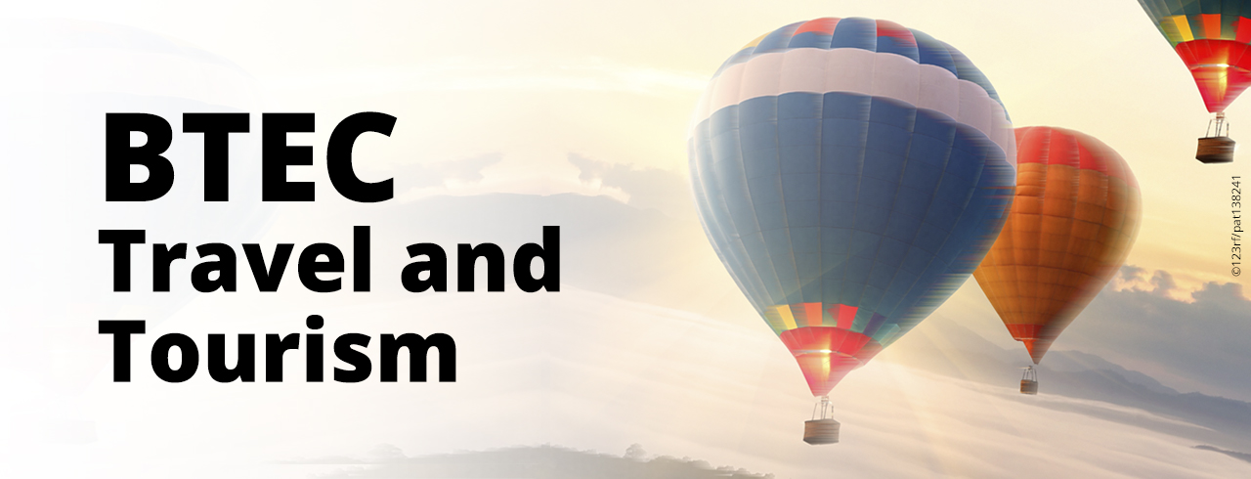
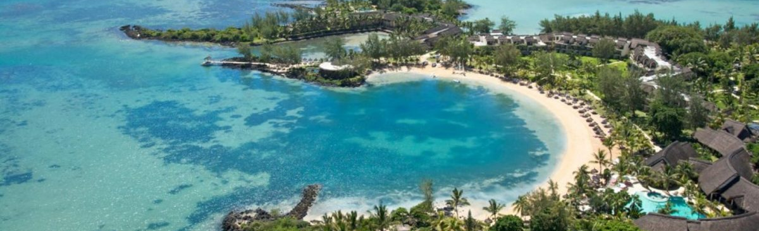
Welcome to Travel and Tourism at NCIC

Slide 2
Wondering if you should study Travel and Tourism at NCIC?

Slide 3
BTEC LEVEL 2 AWARD/ CERTIFCATE
Travel and Tourism is an ideal course for anyone with an interest in developing skills for work.
It’s not just about tourism. We investigate business organisations and structures and how businesses can be successful.
We focus on customer service skills which are vital to any customer facing job in any industry.
Most of the course is independent research and presentation so you will need to be able to work independently on a computer.

Slide 5
Overview of the course
75% coursework, 25% externally moderated exam.
For Single Award Travel and Tourism , there are a total of four units to be covered within the two-year course. This is worth ONE GCSE.
For Double Award Travel and Tourism, there are eight units in total to be covered within the two-year course. This is worth TWO GCSEs

Slide 6
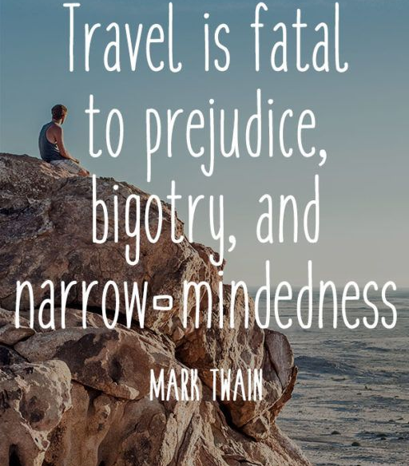

Slide 7
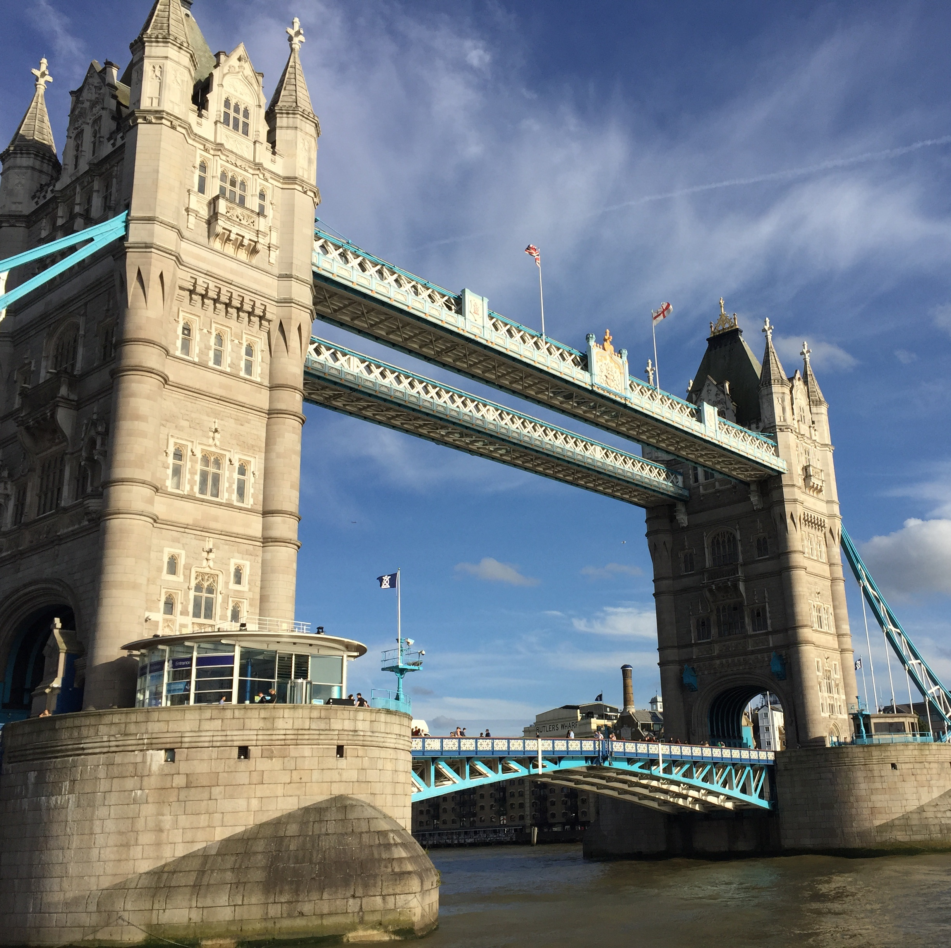
Single Award: course content
YEAR 11:
The UK Travel and Tourism Sector
International Travel destinations
YEAR 12:
Customer Service in Travel and Tourism
UK Travel and Tourism destinations

Slide 9
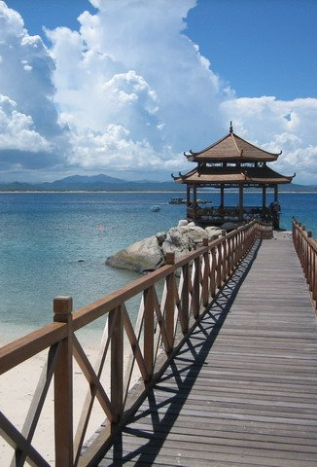
Double Award: course content
You will study the same units as the Single Award class, plus:
YEAR 11:
Airports and Airlines
Travel and Tourism employment opportunities
YEAR 12:
Organising a Travel and Tourism visit
Travel and Tourism Business Environments

Slide 11
Subject links
Travel and Tourism has links with all subjects, for example:
Geography
ICT
Languages
Hospitality
Media
Business Studies

Slide 13
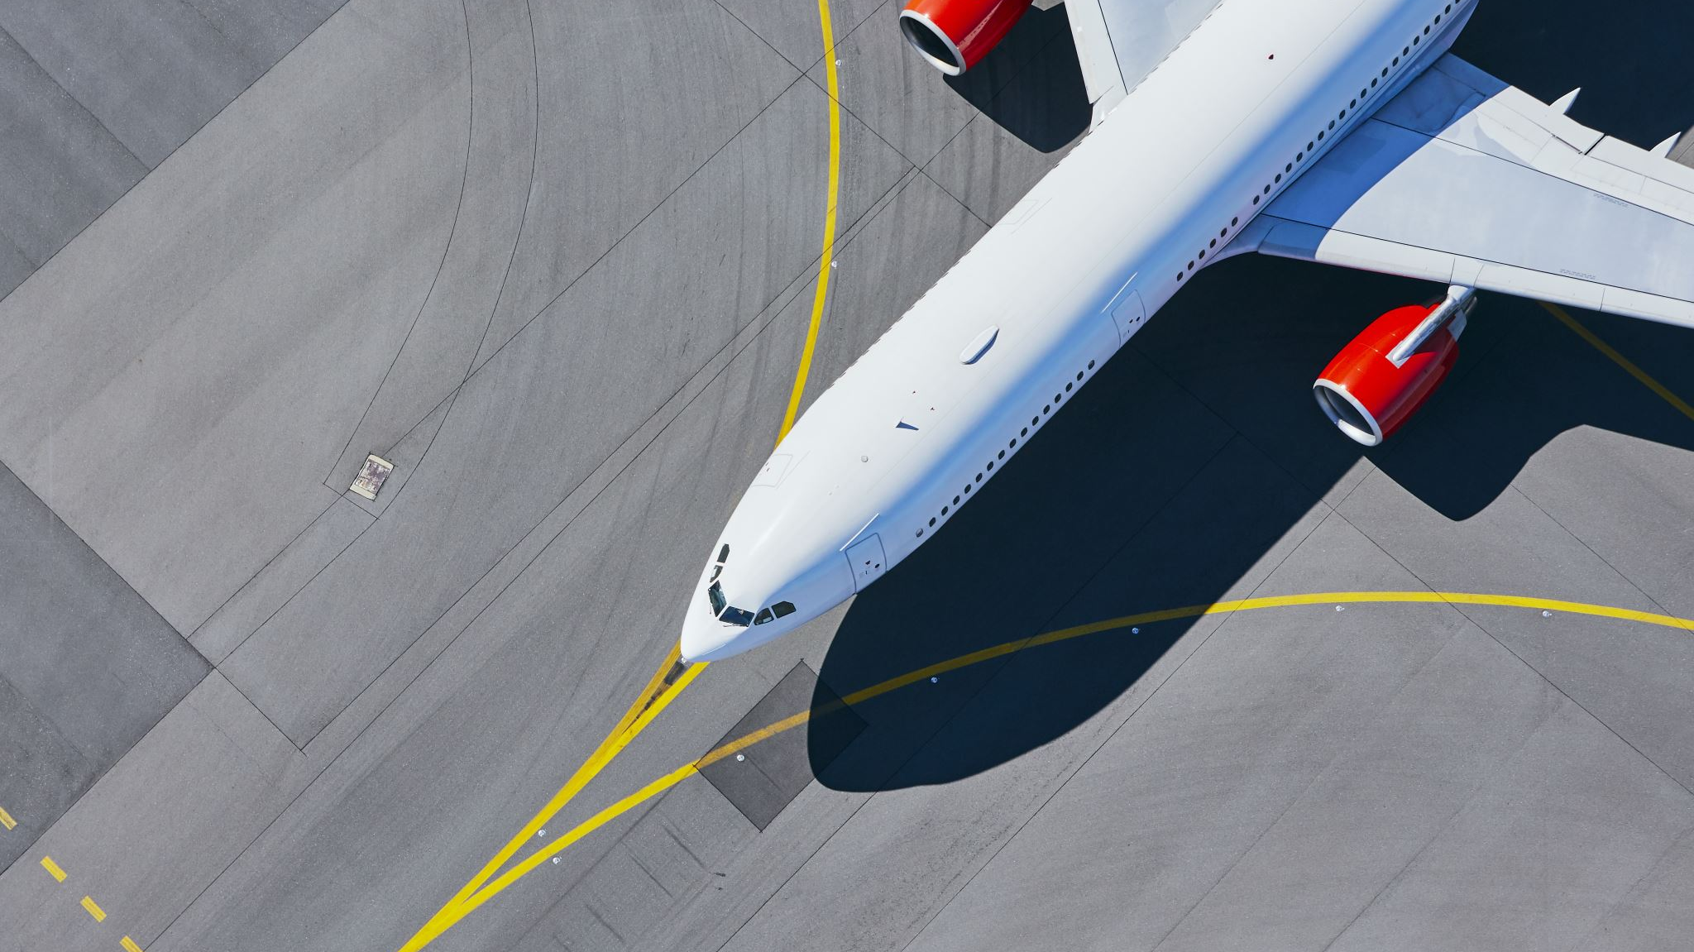
Potential career opportunities in Travel and Tourism
Air cabin crew
Holiday representative
Hotel manager
Tour manager
Tourism officer
On-line travel agent
Influencer marketer
Smart technology developer
Sustainability consultant

Slide 15
How can you ensure you succeed in Travel and Tourism?
You need to have good attendance. As we use class time to continue with coursework, any missed classes means that you will have to catch up in your own time.
Ideally you need to be able to access work at home on a computer.
You need to try to keep up to date with news in the Travel industry- it will help you a lot with your coursework!
This Photo by Unknown author is licensed under CC BY.

Slide 16
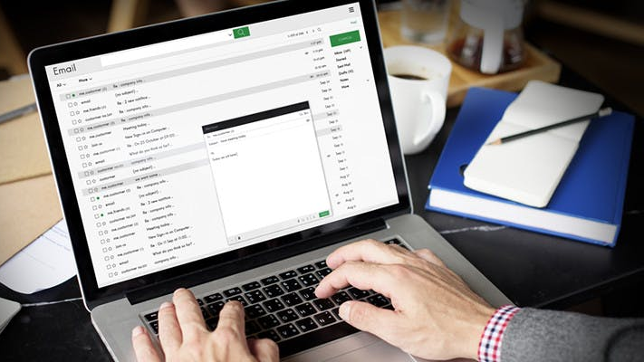
Who can you contact for more information?
Mrs Maguire is the Travel and Tourism Head of Department.
If you have any queries, you can contact Mrs Maguire via email: gmaguire221@c2ken.net or by phone at School.

