Slide 1
Why should I choose English Literature for A Level?

Slide 2
Do you…

Slide 3
…love reading?

Slide 4
…believe in the power of words to shape our thoughts and feelings?

Slide 5
…have an interest in how events in history shape our behaviour?

Slide 6
…consider yourself an amateur psychologist?

Slide 7
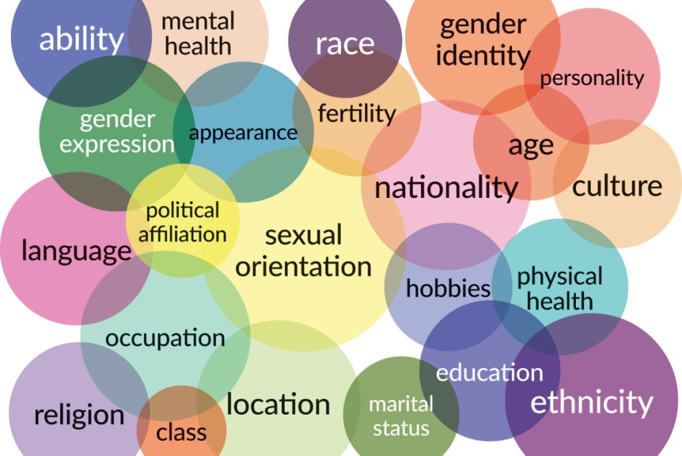
…appreciate the impact that identity and experience have on our lives, and the lives of others?

Slide 8
…enjoy standing your ground to defend your opinions?
JUSTICE!

Slide 9
Then English Literature might be the subject for you!

Slide 10
Studying English Literature has many benefits

Slide 11
Reading is great for your mental health…
Did you that reading every day can…

Slide 12
… improve mental stimulation?

Slide 13
…reduce stress?

Slide 14
…help you to relax?

Slide 15
…bring inner peace and tranquility?

Slide 16
…strengthen analytical and critical thinking skills?

Slide 17
…assist in memory improvement?

Slide 18
…improve focus and concentration?

Slide 19
…improve your vocabulary?

Slide 20
…help you to escape the real world?

Slide 21
…help you to see this world through other lenses?

Slide 22
But that’s not all…

Slide 23
It is a well-respected subject which proves to universities and employers that….

Slide 24
…you have exceptional literacy skills.

Slide 25
…you can think analytically and critically.

Slide 26
…you consider alternative opinions and solutions before making informed decisions.

Slide 27
… you have been taught in a collaborative environment and are able to work as part of a team.

Slide 28
So why not choose a subject that improves your health AND your career prospects?

Slide 29
You’ve convinced me! What will I study?

Slide 30
We study the WJEC A Level English Literature specification

Slide 31
Year 13

Slide 32
English Literature
Unit 1

Slide 33
Pre 1900 Prose

Slide 34
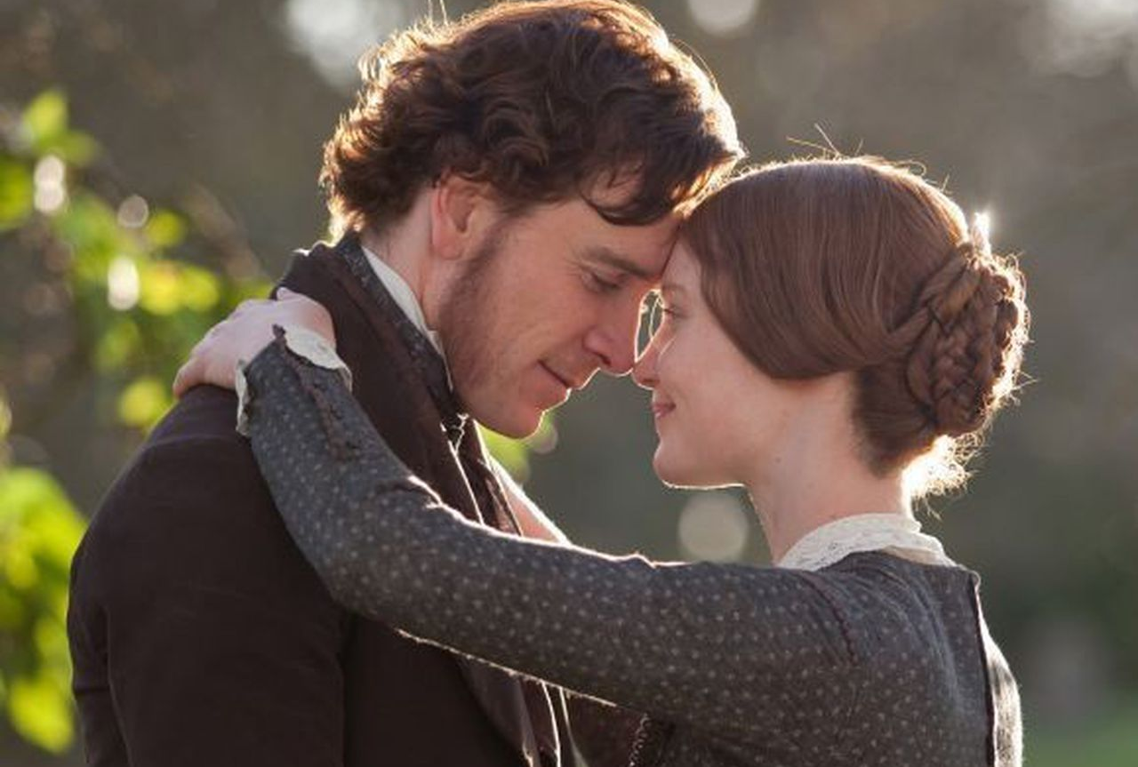
Jane Eyre is a gothic novel by Charlotte Bronte.
It is a mystery story with elements of love and betrayal.

Slide 35
Drama

Slide 36
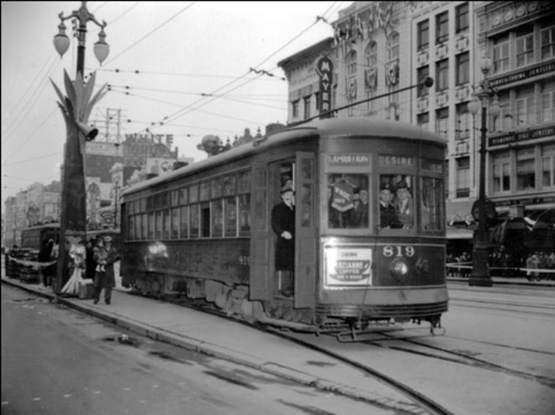
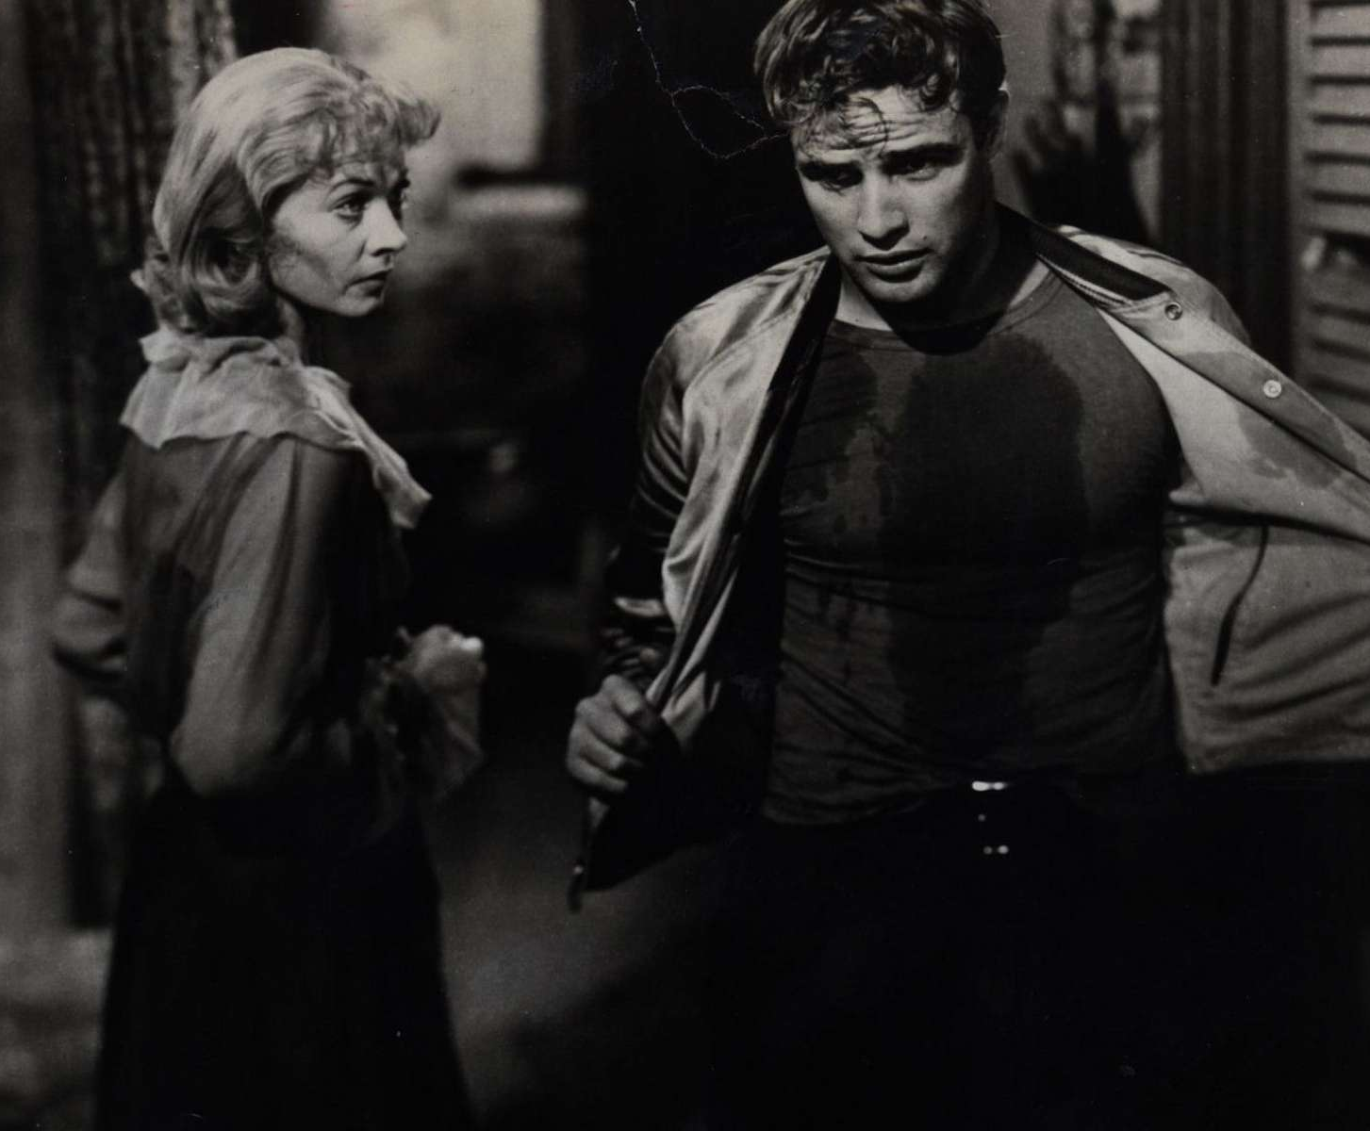
A Streetcar Named Desire is a play by Tennessee Williams.
It is a shocking story of
lust, violence, class and family.

Slide 37
LITERATURE Unit 2

Slide 38
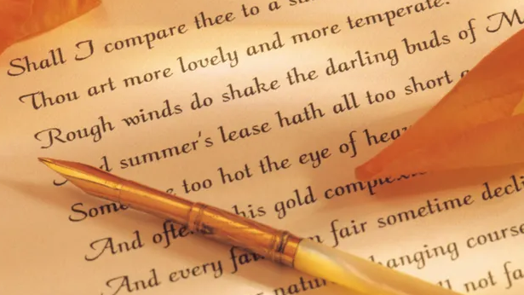
Post 1900 Poetry

Slide 39
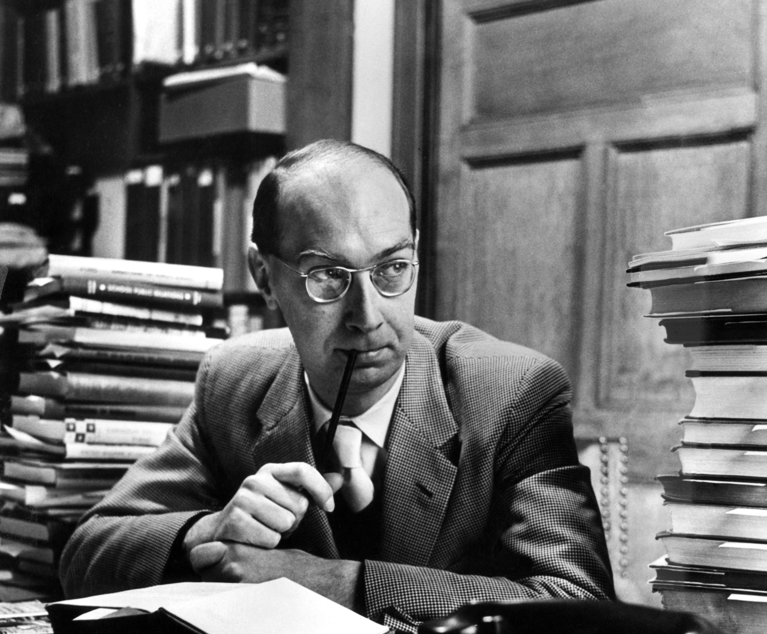
The Whitsun Weddings is an anthology of poetry by Philip Larkin.
The poems include themes of religion, pessimism, boredom, death, and sex.

Slide 40
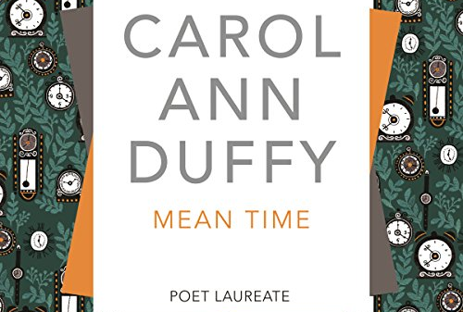
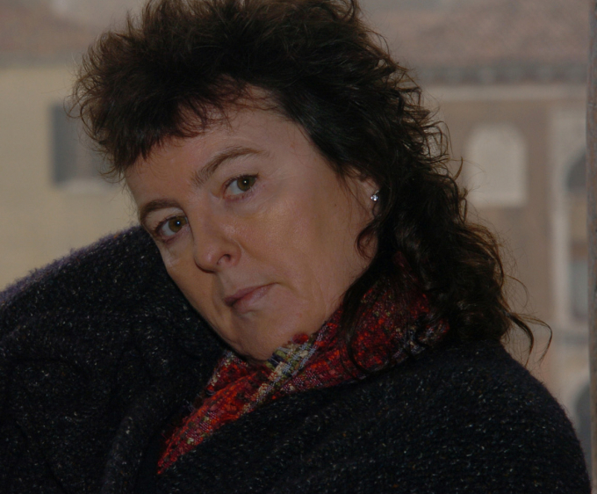
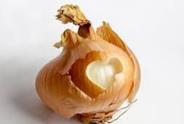
Mean Time is an anthology of poetry by Carol Ann Duffy.
The poems include themes of identity and self, gender, love, and time.

Slide 41
Year 14

Slide 42
English Literature
Unit 3

Slide 43
Pre 1900 Poetry

Slide 44
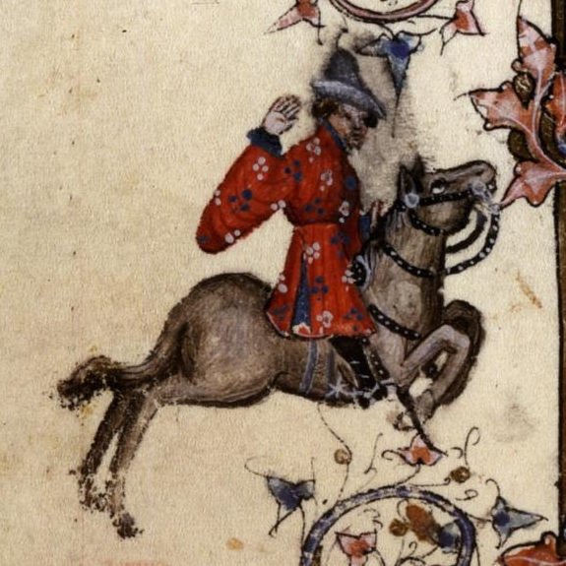
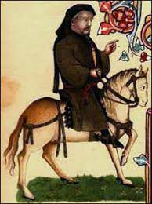
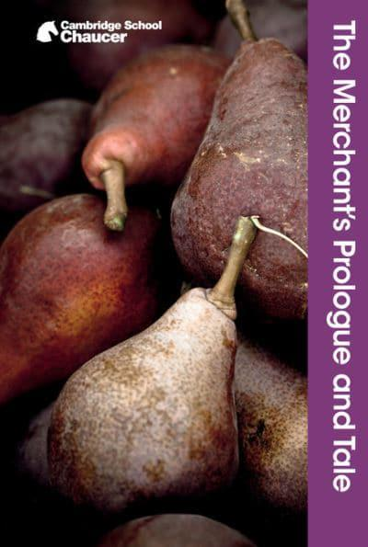
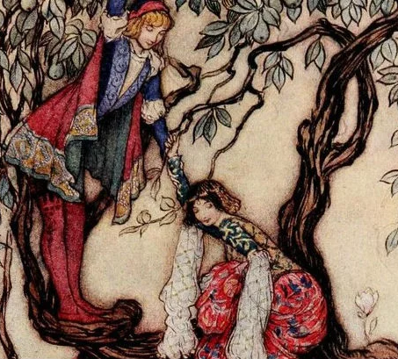
Geoffrey Chaucer was the first person to write extensively in English.
The Merchant’s Tale is a saucy poem about the marriage between a very old man and a very young woman.
Spoiler alert… it doesn’t go well!

Slide 45
Unseen Poetry

Slide 46
In an unseen poetry question, you will be asked to analyse poetry which is unfamiliar.

Slide 47
LITERATURE Unit 4

Slide 48
Shakespeare

Slide 49
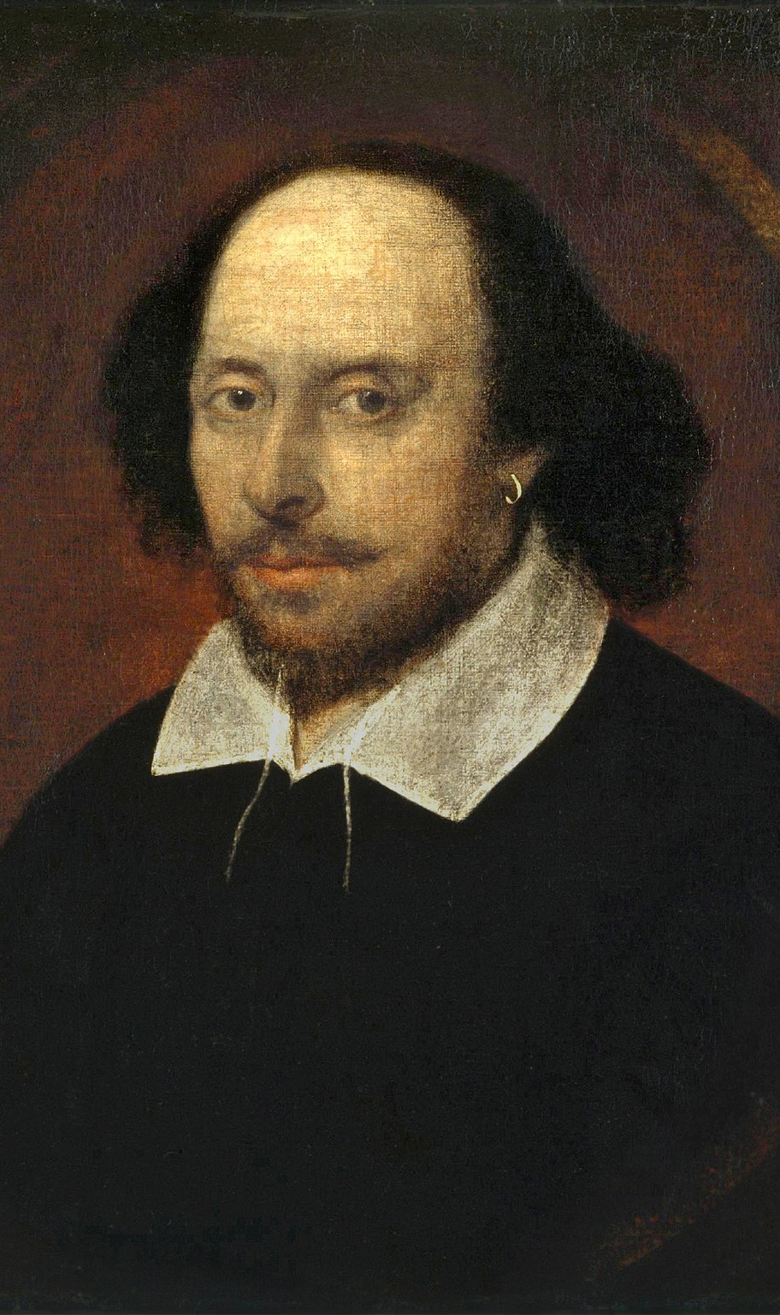
Hamlet was written by William Shakespeare. It is a play about murder, corruption and revenge.

Slide 50
LITERATURE
UNIT 5

Slide 51
Prose Coursework

Slide 52
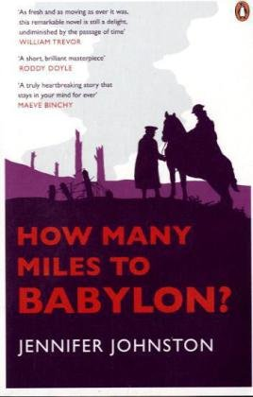
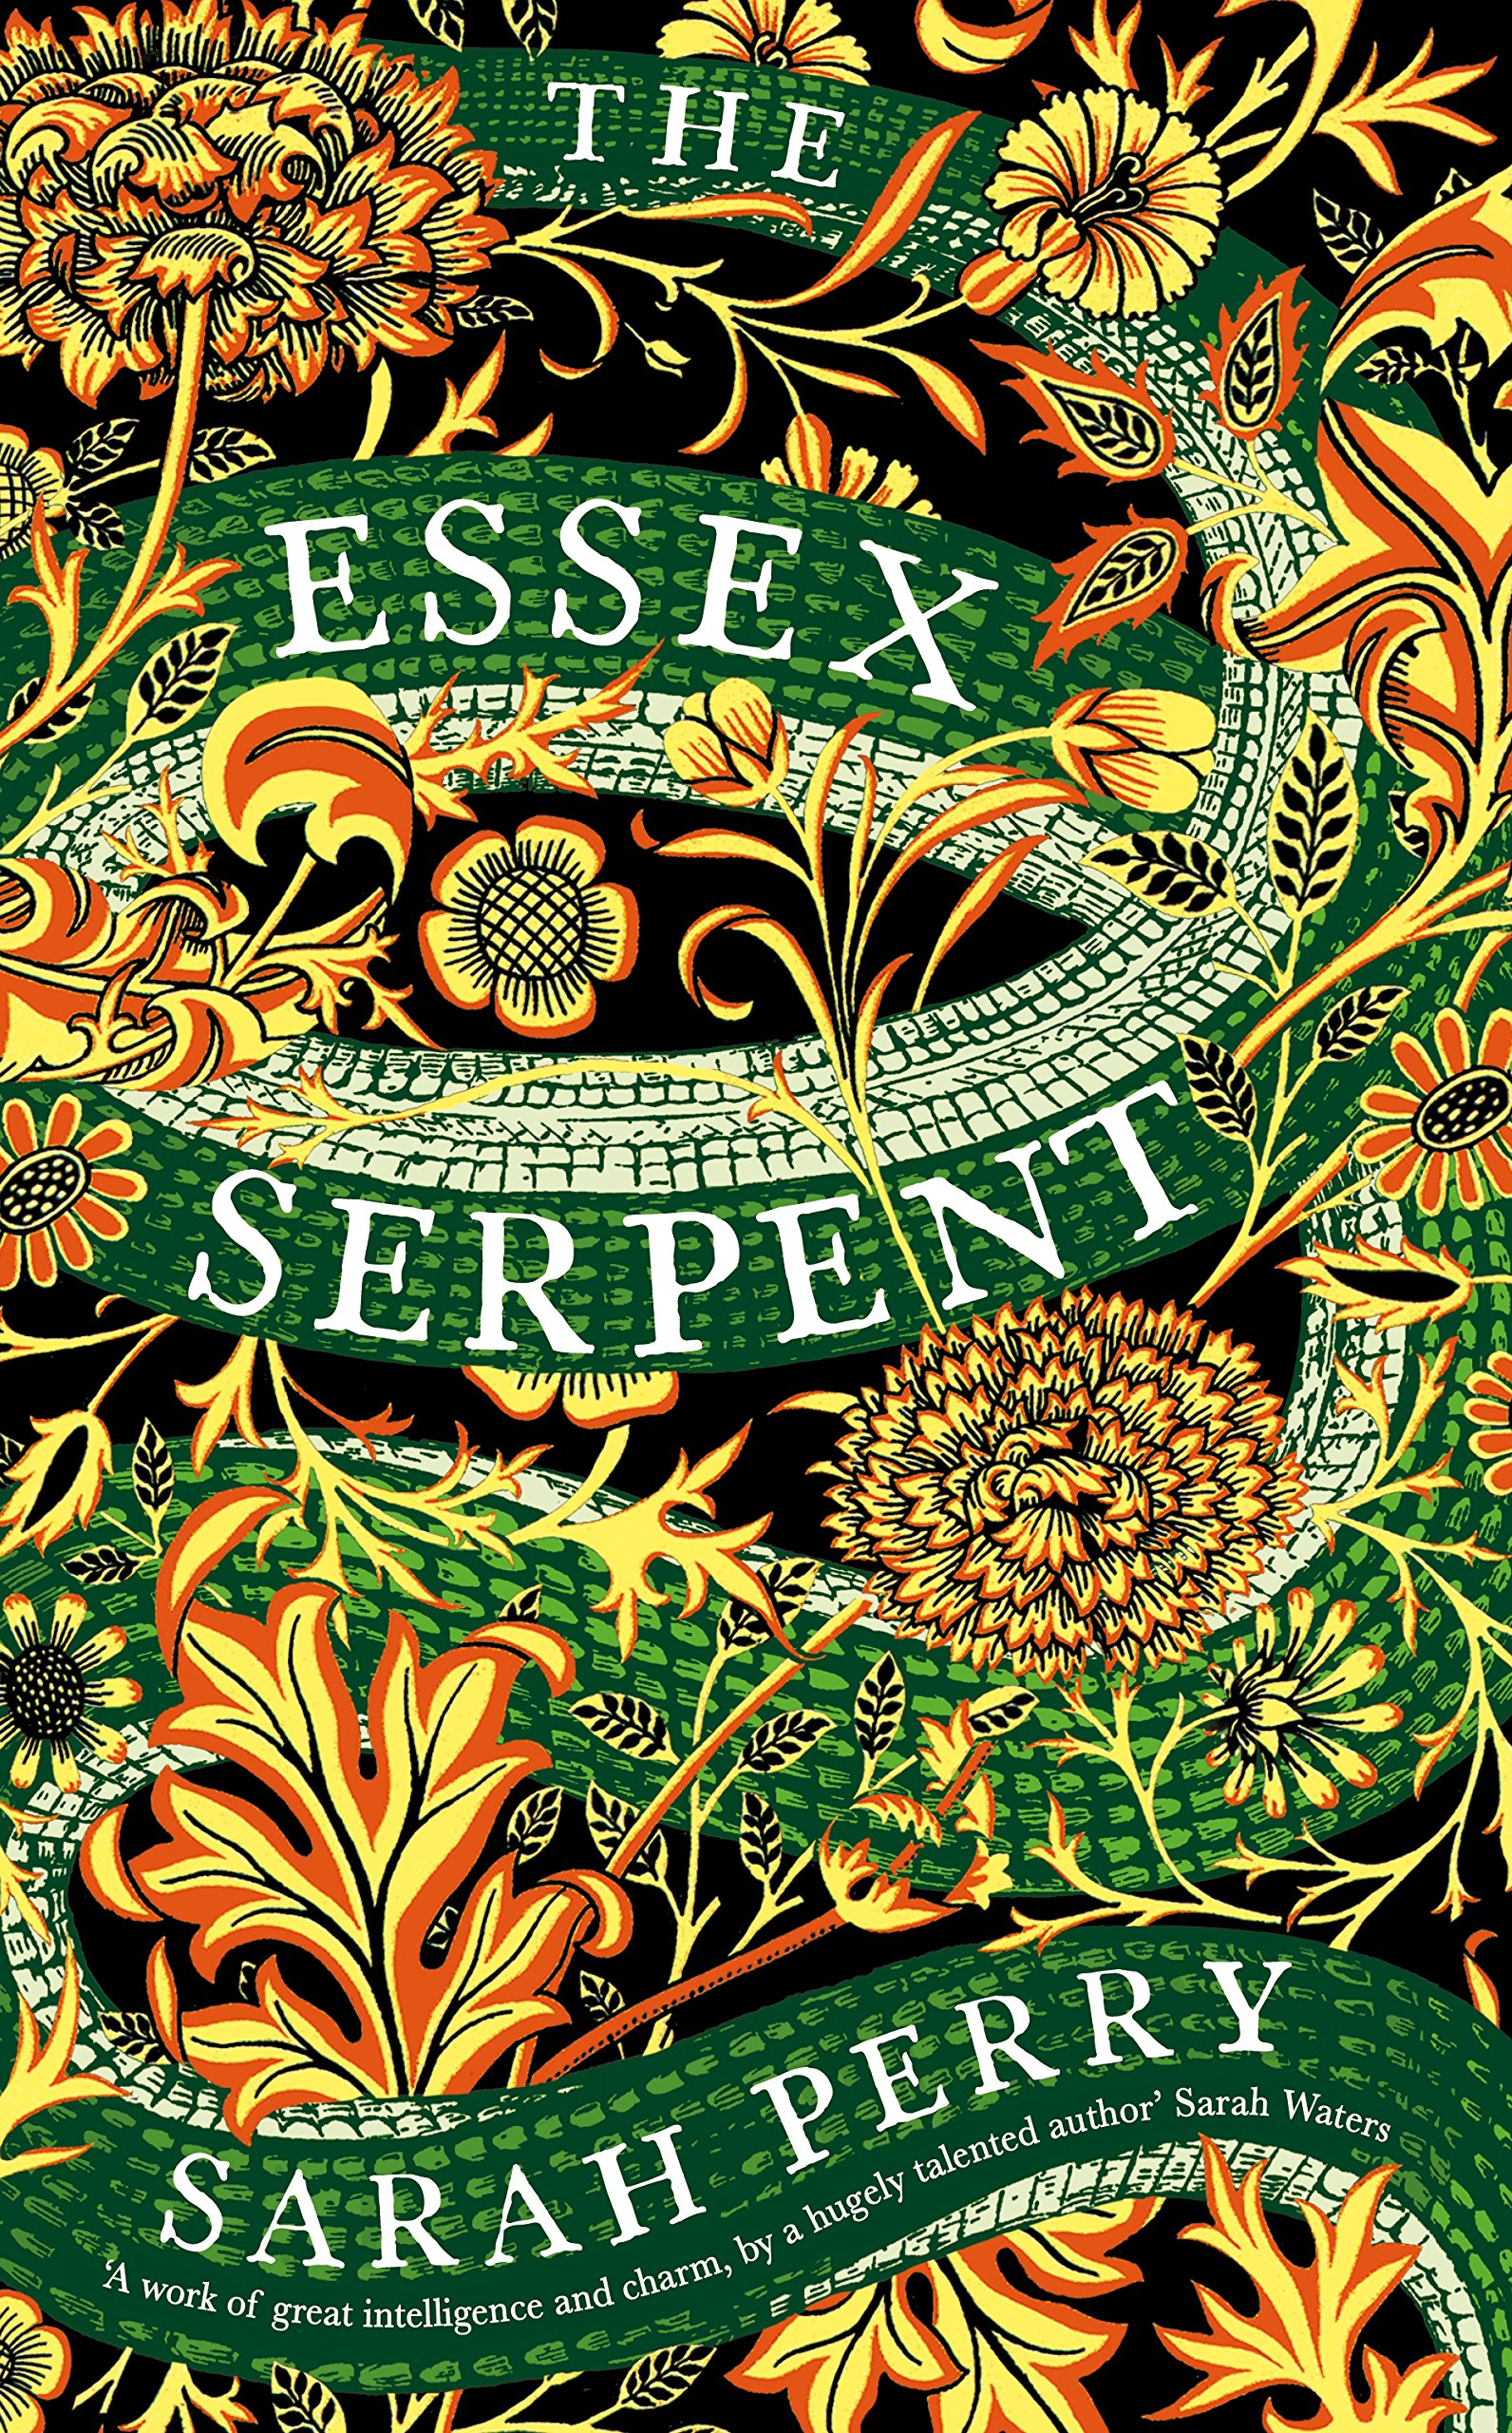
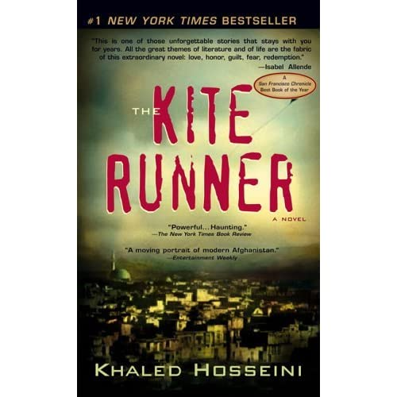
The prose coursework gives you a chance to explore novels which interest you – pick from a range of modern and classic novels and compare how their stories affect and reflect our understanding of society.

Slide 53
You’ve sold it… English Literature is the subject for me. What do I do now?

Slide 54
If you want to know more about English Literature, come and visit Mrs Casson or Mrs Neill

Slide 55
Or, if you’d rather, you can email us: nneill329@c2ken.net ecasson537@c2ken.net

