Slide 1
‘A’ Level Biology

Slide 2
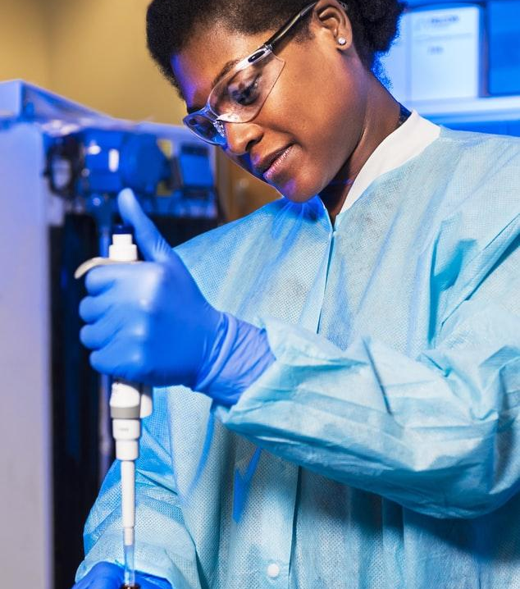
Why study ‘A’ Level Biology ?

Slide 3
Course aims
The CCEA GCE Biology specification gives students a deeper knowledge of the organisms that share our planet. They learn about how organisms are built, how they function and how they interact with each other and their surroundings.
Students carry out and report on practical activities that are designed to help them understand concepts and processes and demonstrate biological phenomena.
They also appreciate how society makes decisions about scientific issues and how the sciences contribute to the success of the economy and society.
Students look at contemporary developments in biology. For example, they learn about how a disrupted cell cycle contributes to the development of cancer. They also find out how some anticancer medications work to bring the disease under control.
This specification is available at two levels: AS and A2. Students can take the AS units plus the A2 units for a full GCE A level qualification. They can also choose to take the AS course as a stand-alone qualification.

Slide 4
Entry requirements
A minimum of a grade B in the Biology Higher theory papers in Double Award Science is required for this course and a grade C in Mathematics.

Slide 5
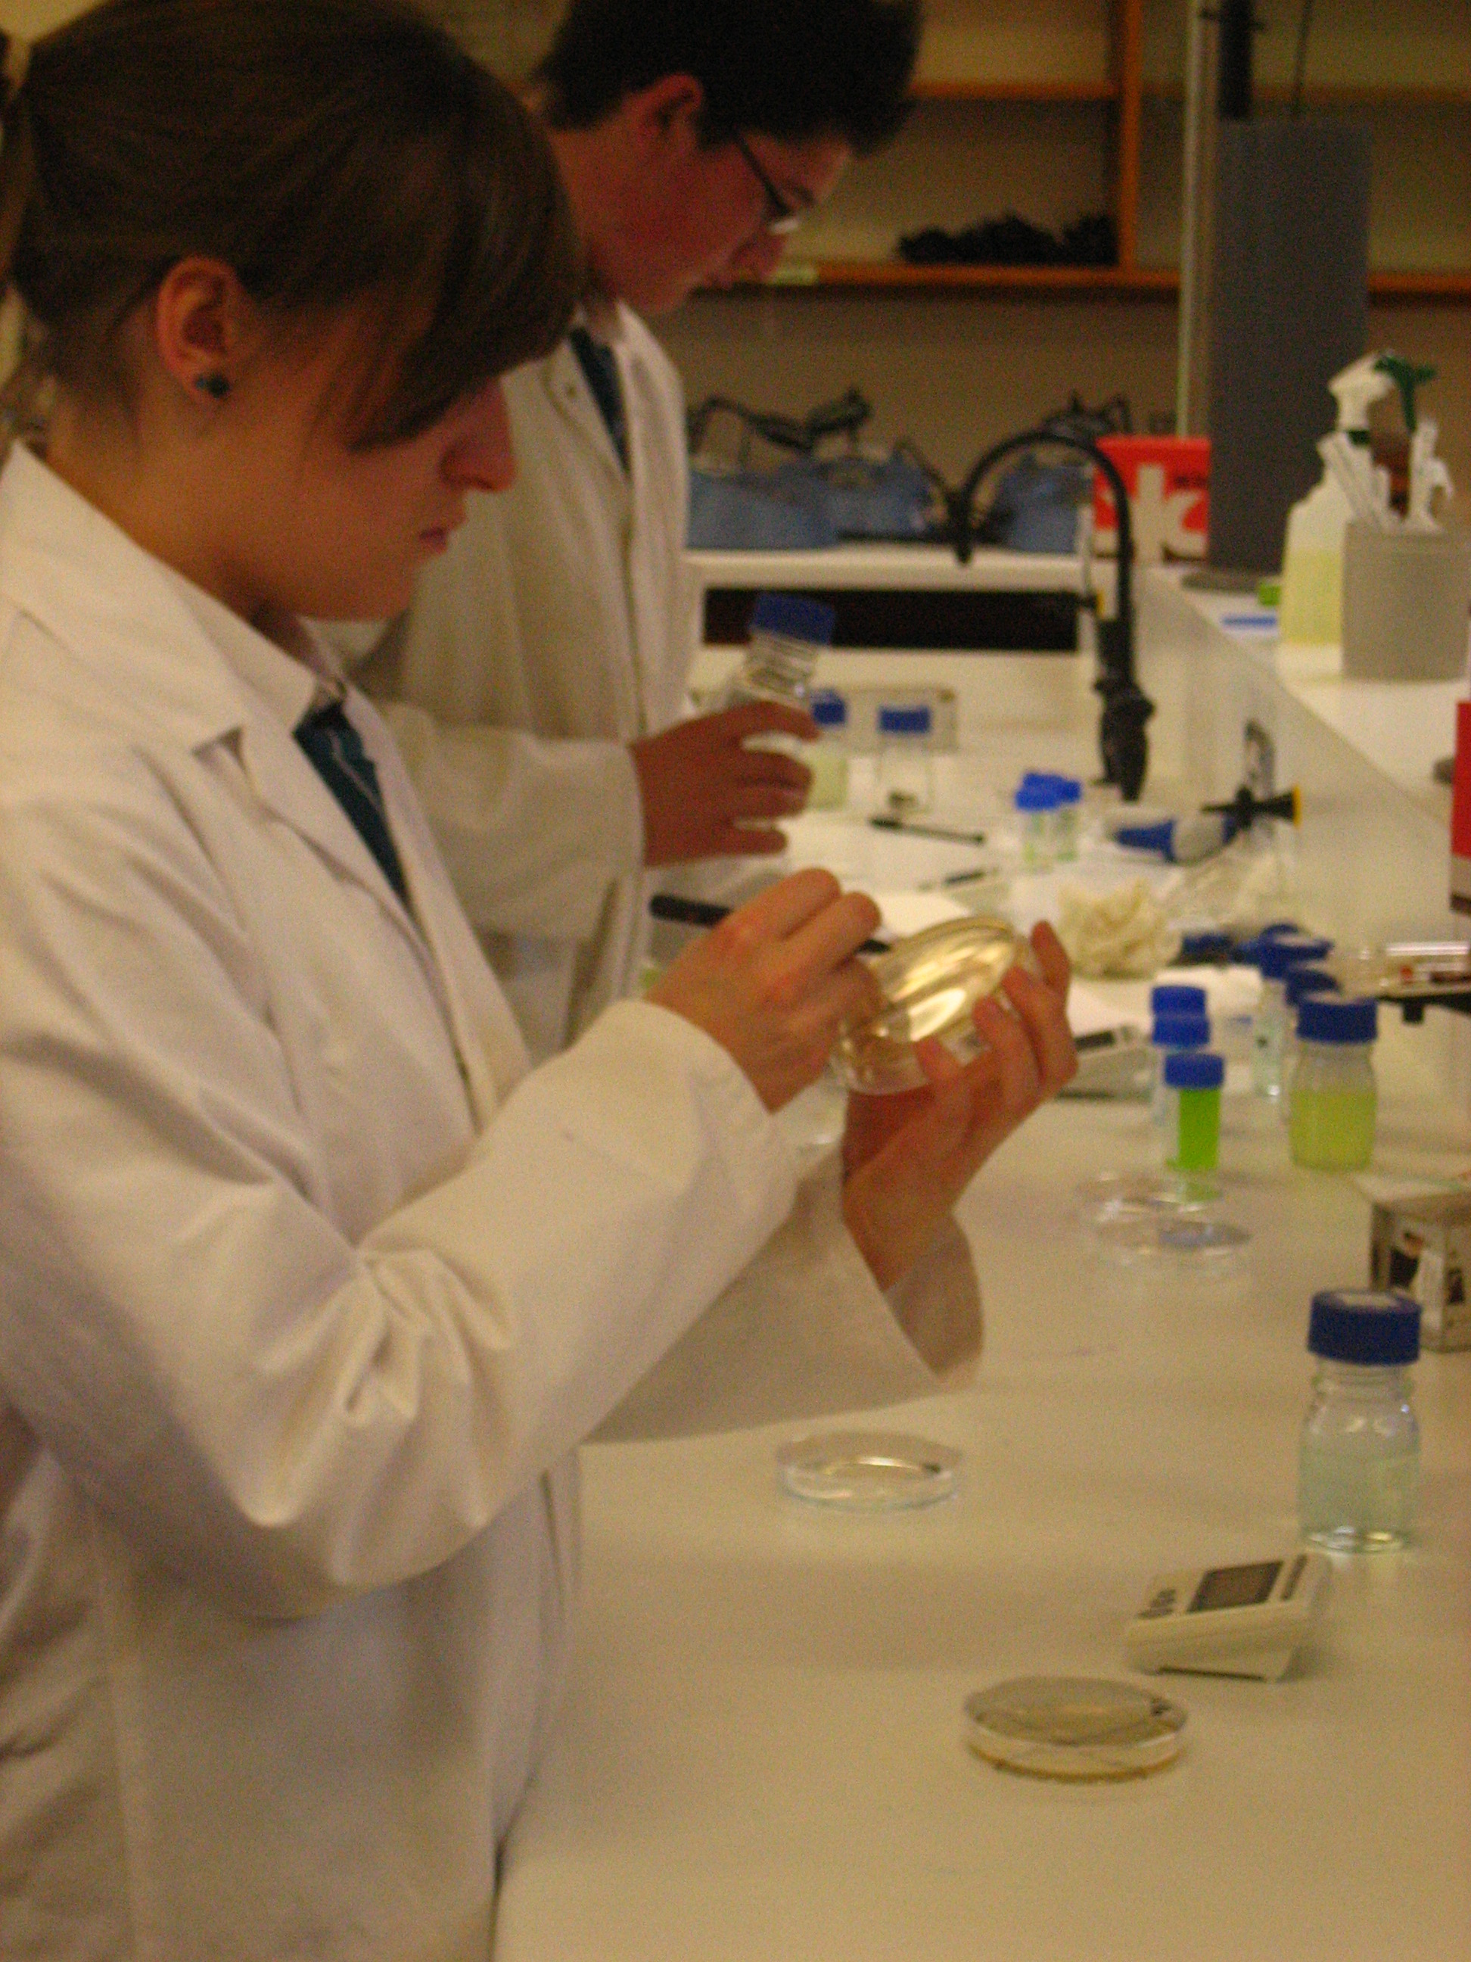
Course Content

Slide 6
AS Biology
1
Molecules and
cells
External examination – 37.5% of AS grade and 15% of ‘A’ Level Biology
2
External examination – 37.5% of AS grade and 15% of ‘A’ Level Biology
Organisms and
Biodiversity
3
Internal practical assessment and 1 hour external written exam – 25% of AS grade and 10% of ‘A’ Level Biology
Practical
skills

Slide 7
A2 Biology
1
Physiology, Co-
ordination and
control and
Ecosystems
External examination – 24% of ‘A’ Level Biology
2
External examination – 24% of ‘A’ Level Biology
Biochemistry, genetics and
Evolutionary Trends
3
Internal practical assessment and 1.25 hour external written exam – 12% of ‘A’ Level Biology
Practical
skills

Slide 8
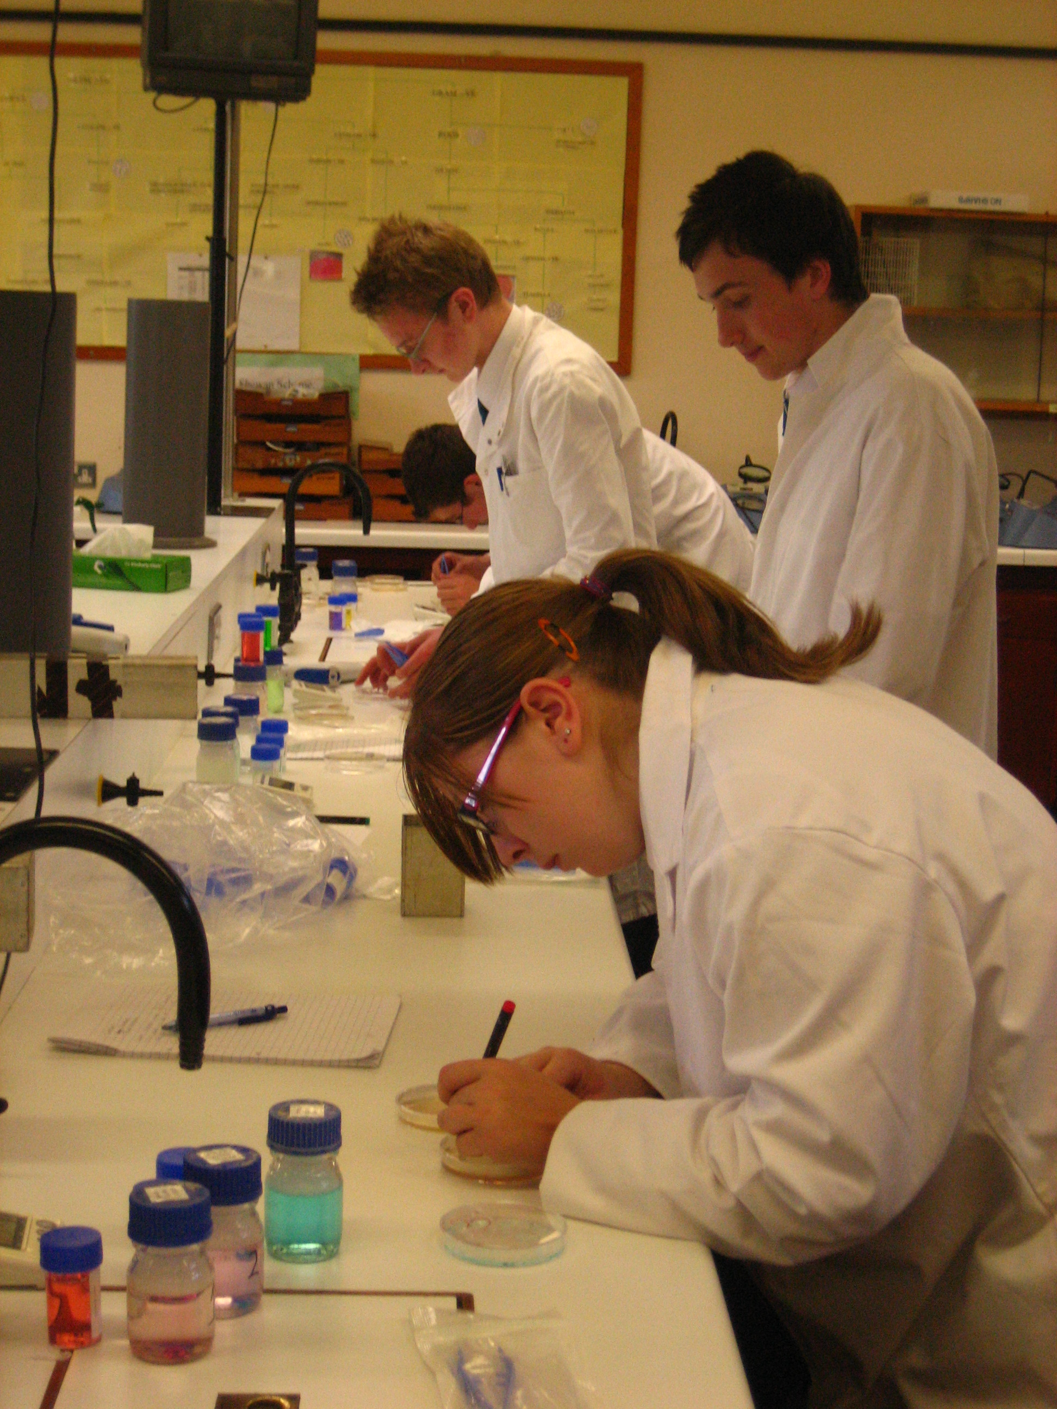
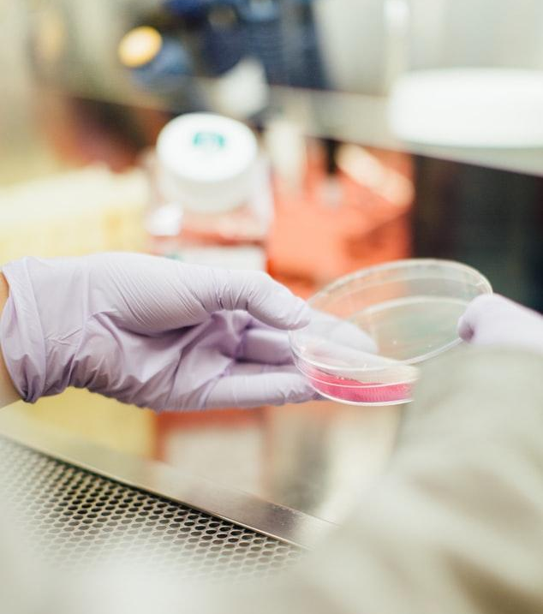

Slide 9
89,526,124
Career options
Whoa! That’s a big number, aren’t you proud?

Slide 10
Career opportunities
Medicine
Nursing
Dentistry
Veterinary
science
Speech and language therapy
Pharmacology
Physiology
Biomedical
Science
Forensic Science
Agriculture
Marine Biologist
Lecturer

Slide 11
Any Questions?
Please feel free to send an email to Mrs Brown vbrown989@c2ken.net
with any questions you have about BTEC Applied Science or by phone at school.

