Slide 1
North Coast Integrated College
Technology & Design Department

Slide 2
GCSE Choices
GSCE Construction & The Built Environment

Slide 3
GCSE Construction & The Built Environment
This subject is useful for those interested in a career within the Construction Industry. This may be in a professional capacity (Architect, Quantity Surveyor, Civil Engineer etc.) or in a Crafts Occupation (Bricklayer, Plumber, Electrician etc.).
The course takes into consideration the Construction Process and the wide variety of structures that comprise the Built Environment but mainly focuses on Domestic Construction (houses).
There are 4 units within this subject:

Slide 4
Units 1 & 2 (Exam Units)
1. Introduction to the Built Environment (20% of overall subject mark)
This unit is an external written exam that focuses on the wider construction process including the Range of Structures completed, Health and Safety issues and Careers within the Industry.
2. Sustainable Construction (30% of overall subject mark)
This unit is also an external written exam. It is much more focused on Domestic Construction and the various building components within it (Doors, Walls, Foundations etc.) as well as reading existing drawings to find information.

Slide 5
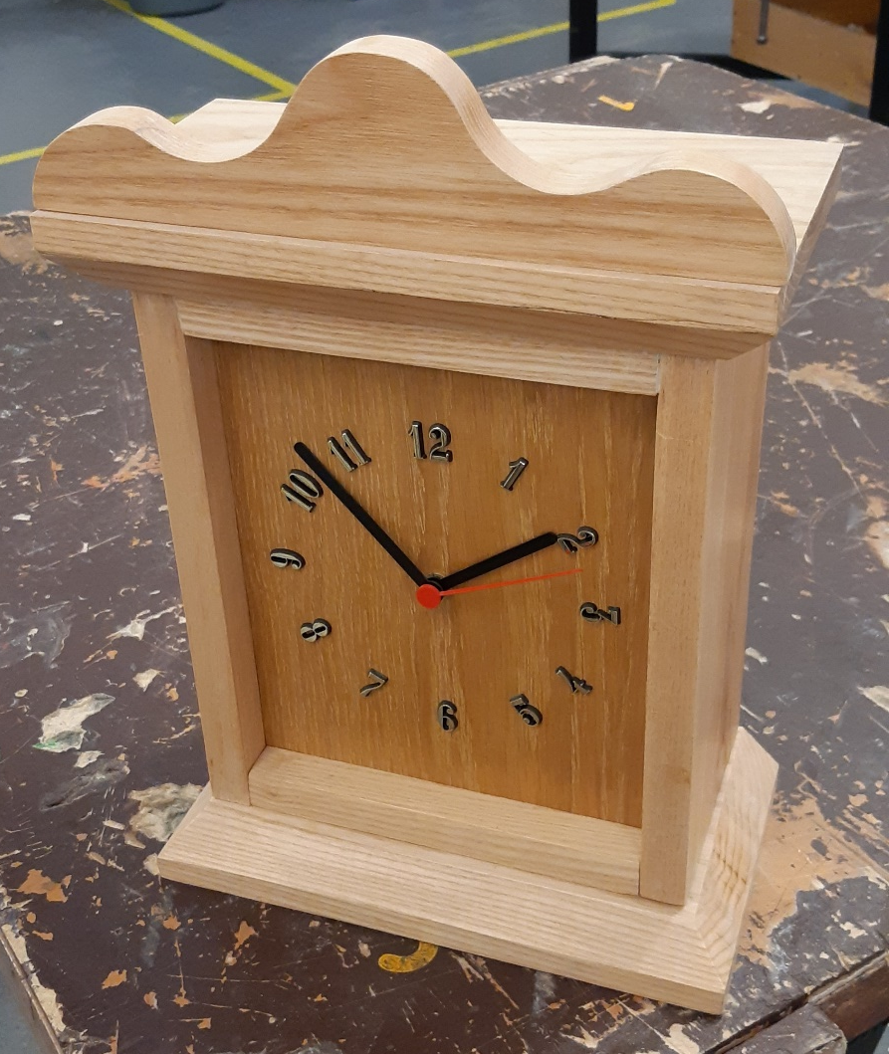
Units 3 & 4 (Practical Units)
3. The Construction Craft Project (25% of overall subject mark)
This is mainly a practical unit where students manufacture a wooden product (table, steps etc.) from designs provided by the Exam Board. There is also a short evaluation section to be completed by each candidate.
This is marked by the department for accuracy and quality of finish and then moderated by a visiting examiner.

Slide 6
4. Computer Aided Design in Construction (25% of overall subject mark)
This is a practical unit where students use the AutoCAD drawing software to copy a range of drawings relating to a domestic dwelling. These drawing are provided by the Exam Board on a two-year cycle.
The drawings are marked by the department and then sent for external moderation by the Exam Board.

Slide 7
Qualities required for success in GCSE Construction
In order to achieve your potential in this subject, important qualities are:
Perseverance, focus on task, the ability to work on your own initiative (taking instruction then putting it into practice).
As the course is 50% coursework, a good attendance is imperative as these tasks cannot be completed outside of school.

