Slide 1
Double Award Science option for year 10

Slide 2
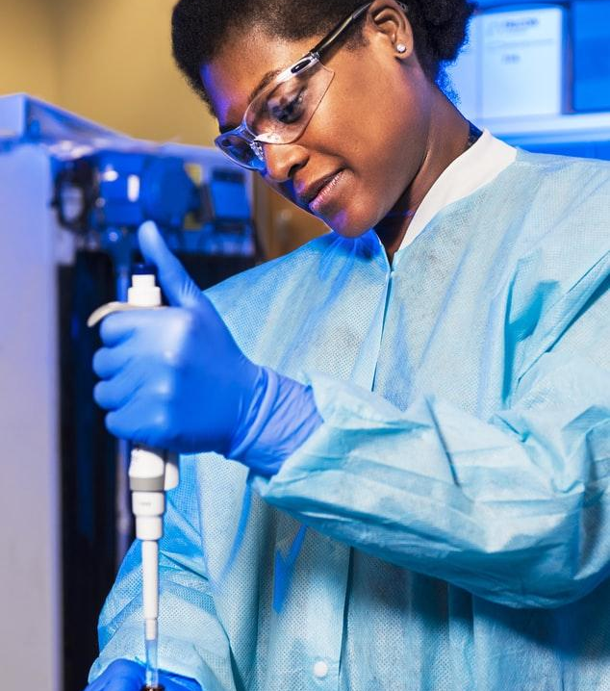
Why study Double Award Science at GCSE?

Slide 3
Course aims
Double Award Science qualification provides a broad, coherent and practical course that develops confidence in and a positive view of science. It encourages you to appreciate the value of science in your life and in the wider world around you.
You will develop your knowledge and understanding of the material, physical and living worlds, the effects of science on society so that you can apply your practical and problem-solving skills in the laboratory.
Through the course you will develop your skills in communication, mathematics and the use of technology in scientific contexts.
Double Award Science is suitable for people who wish to leave their options open and who may wish to study a science Post-16. Pupils must be working at level 5 or above at Key Stage 3.

Slide 4
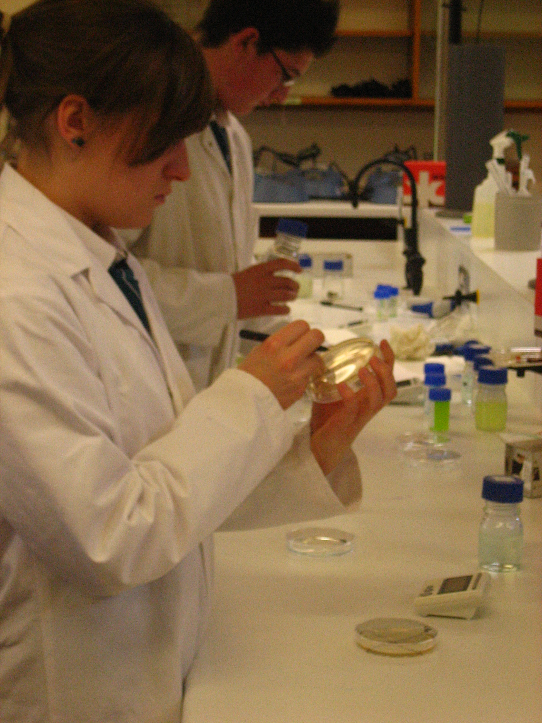
Course Content

Slide 5
Year 11
B1
Cells, Photosynthesis and Plants, Food and energy, Digestion, Respiration, Nervous System, Ecological Relationships and Energy flow.
External examination - 11% of GCSE
Biology
C1
Atomic structure, Bonding and Structure, Symbols, Formula and Equations, Quantitative chemistry 1, Periodic table, Acids, bases and salts and Chemical analysis
External examination - 11% of GCSE
Chemistry
P1
Physics
Motion, Forces, Application of forces, Density and kinetic energy, Energy, Radioactivity
External examination - 11% of GCSE

Slide 6
Year 12
B2
Osmosis, Circulatory system, Genetics, Reproduction, Variation and Health
External examination - 14% of GCSE
Biology
C2
Reactivity, Gas chemistry, Redox, Equilibrium, Organic Chemistry, Quantitative Chemistry 2, Electrochemistry, Energy changes in chemistry
External examination - 14% of GCSE
Chemistry
P2
Physics
Waves, Light, Electricity, Electricity in the home, Space Physics, Magnetism
External examination - 14% of GCSE

Slide 7
Unit 7 Practial Skills – 25% of GCSE
Booklet A 7.5%
Practical skills assessment
Students carry out 3 practical tasks lasting 1 hour paper in Biology, Chemistry and Physics.
Booklet B 17.5%
External Examination
Students answer compulsory structured questions that include short responses, extended writing and calculations in Biology, Chemistry and Physics

Slide 8
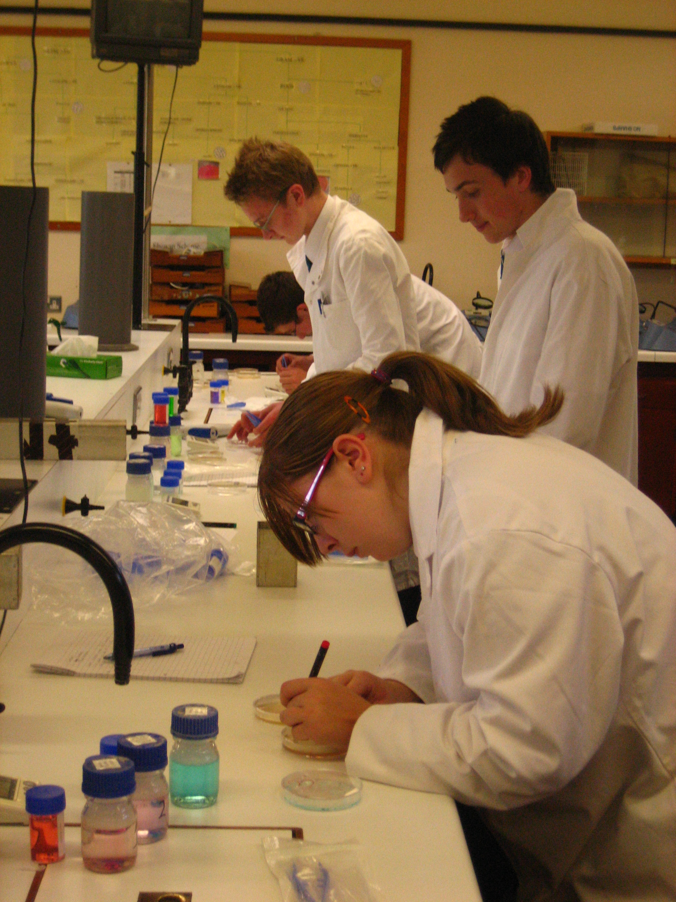
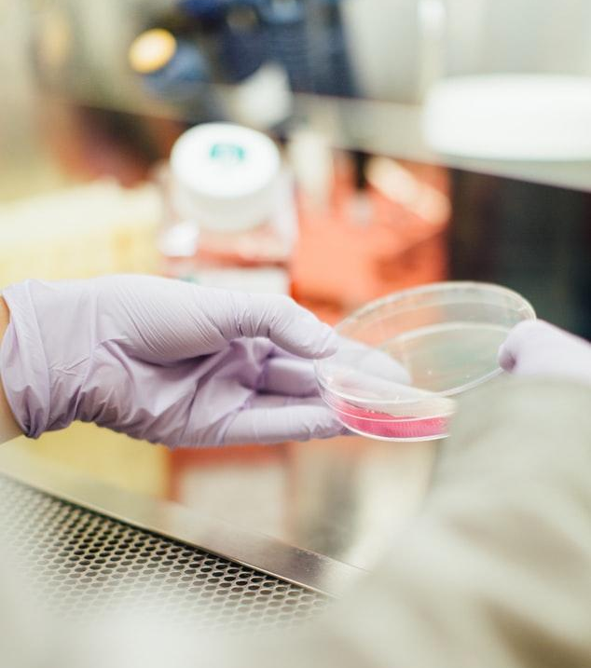

Slide 9
89,526,124
Career options
Whoa! That’s a big number, aren’t you proud?

Slide 10
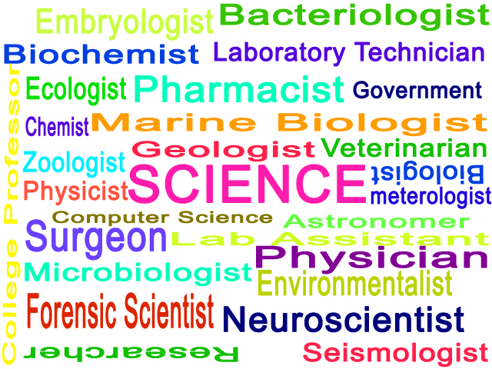

Slide 11
Any Questions?
Please feel free to send an email to Mrs Brown (Head of Science) vbrown989@c2ken.net
with any questions you have about GCSE Double Award Science or by phone at school.

