Slide 1
BUSINESS STUDIES OPTION FOR YEAR 10S
BUSINESS DEPARTMENT January 2022
Press F5 for automatic presentation and audio commentary

Slide 2
COURSE AIM
Business covers a broad range of fields, including retail, human resources, finance, law, sales, marketing and administration. Students have the opportunity to study the importance of Business and Communication Systems which contribute to the success of a business. In particular students will consider how ICT systems affect the way people work and how they potentially improve communication both internally and externally. Students will:
Be introduced to the various aspects of the world of business.
Acquire useful practical skills in a wide range of areas.
Acquire the knowledge and skills to become financially independent.
Develop skills which lead to a number of career paths e.g. finance, business, IT, teaching and many, many more!

Slide 3
Who should study Business Studies?
Can anyone do business studies?
No prior attainment is required to study this course. You should be a person who is interested in the business world and keen to learn how top entrepreneurs have succeeded in their chosen fields. Those of you interested in ICT will have a big advantage in Business Studies as a unit in the course will test your skills in Word, Power Point, Excel and Access
Progression Opportunities
Becoming knowledgeable about how businesses operate helps increase your competitiveness in the job market and to understand how the businesses and governments drive our world economies. Business Studies is highly desirable for many careers whether they are directly business related or will be useful to complement another career path. Students can further their study at year 13 by completing: OCR Cambridge Technical Business Extended Course

Slide 4
CCEA GCSE Business and Communication Systems
What you will be studying:
Unit 1: Software Applications for Business (Year 11: 40% of overall GCSE)
Unit 2: The Business Environment (Year 12: 35% of overall GCSE)
Unit 3: Developing Digital Solutions (Year 12: 25% of overall GCSE)
Mode of Assessment:
1. Computer based exam (40%)
2. Written Exam (35%)
3. Controlled Assessment (25%)

Slide 5
COURSE CONTENT - YEAR 11 Unit 1: Software Applications for Business – 2 Hour computer-based Exam
Unit 1 Topics
File Management
Common Software Application tasks
Word Processing Software
Spreadsheet Software
Database Software
Presentation Software (PowerPoint)
Web Authoring Software (Web Design)
Web Browsing Software
Internet Searching
Email Software

Slide 6
COURSE CONTENT - YEAR 12 Unit 2: The Business Environment
1 hour Written exam in the summer of year 12 on the following topics:
Types of business ownership
Stakeholders
Communication
Digital Trading
Recruitment
Trading
Implications of Digital Technology
Marketing
Market Research

Slide 7
COURSE CONTENT - YEAR 12 Unit 3: Developing Digital Solutions
This is controlled assessment that takes your knowledge of Units 1 and 2 and gives you practical tasks
Planning and research
Using software applications
Evaluation

Slide 8
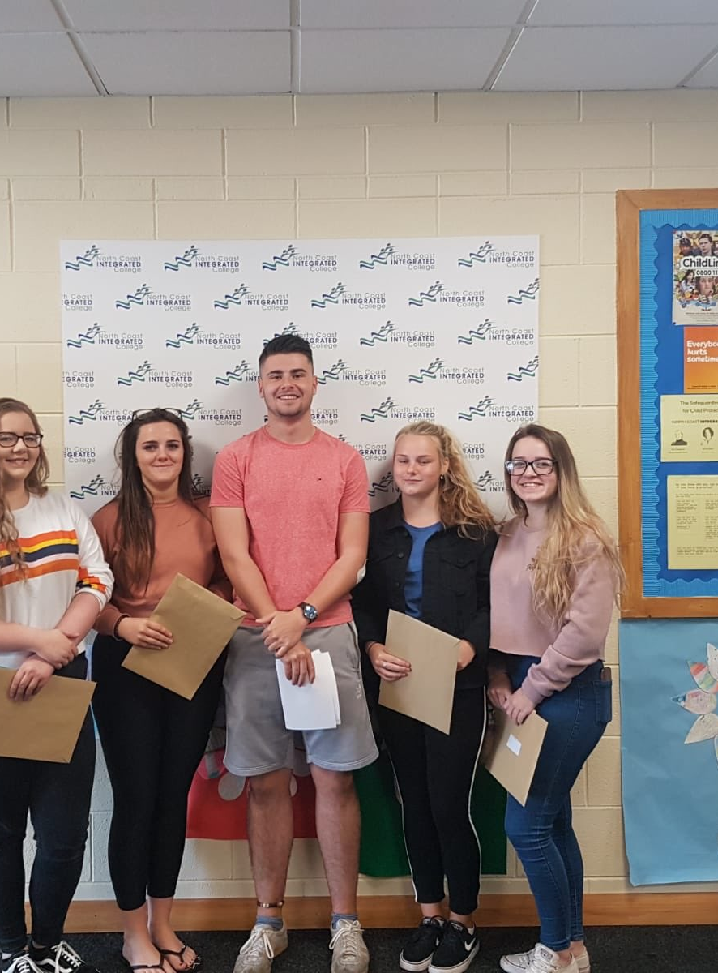
By choosing Business Studies you are:
Choosing a modern qualification lots of employers want skills in
Getting to work in modern and well-equipped computer labs
Opening up many career paths that lead to well-paid jobs
Developing lots of computer-based skills
Studying a subject that is challenging, enjoying and fitting for the modern world
Getting to experience real-life Business transactions in partnership with Young Enterprise

Slide 9
Careers that a qualification in Business Studies can lead to
Bank manager
Business analyst
Business development manager
Business project manager
Customer services manager
Digital marketer
Estate Agent
Financial Adviser
Human Resources Officer
Investment Analyst
Management Consultant
Market Researcher
Public Relations Officer
Retail Buyer
Retail Merchandiser
Road Transport Manager
Sales Manager
Social Media Manager

Slide 10
Any further questions?
Please feel free to send an email message to Mr Moran gmoran263@c2ken.net or Mrs Shaw rshaw387@c2ken.net with any questions you have about your options and the Business and Communication Systems course
Or feel free to call in to talk to these teachers who will be delighted to hear from you

