Slide 1
OSQ SPORT with Mr Strong

Slide 2
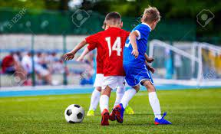
What does it involve?
In Yr 11 you will study a module called ‘Running a Leisure Event’, which will require you to work as a team with class mates to organise a leisure event.
This will probably be a 5 a side football tournament, either for our Yr 8-10 pupils or else for local primary schools.
You will complete a portfolio throughout the year.
There is no exam, just ongoing coursework.

Slide 3
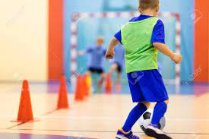
In Yr 12, you will study a module called ‘Sport Leadership’
You will complete a portfolio and be assessed taking a Yr 8 class in the hall for a session of bench football.
You will just take 20 mins of the double period.
You will learn about communication skills, how to create a session plan, about sports careers etc.
Again, no exam, just coursework!

Slide 4
Portfolio structure for both units:
A01 (20%) – Pupils have to show knowledge of the course content and answer questions about the unit including relevant careers and environmental concerns
A02 (60%) – The main part of the portfolio with all the work done through the year. The assessment makes up the bulk of this 60%.
A03 (20%) - Pupils have to evaluate the whole unit and several individual tasks from it, answering questions such as ‘What did I enjoy/not enjoy?’, ‘How could I improve?’ etc.

Slide 5
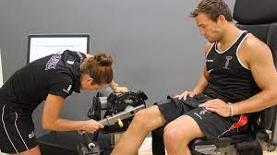
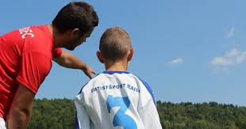
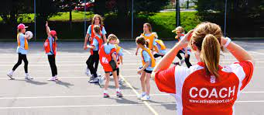
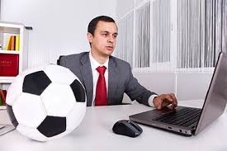
Possible Careers in Sport
Coach of various sports
Lifeguard/pool attendant
Physio
Sports development officer
Leisure centre manager
PE teacher
Referee
Personal Trainer
Manager

Slide 6
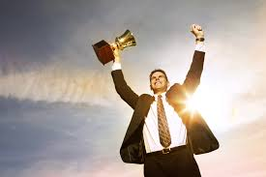
Excellent success rate!!
Almost all of our students who have taken this course in the last 10 years have passed it, gaining the equivalent of a GCSE at Grade C and above.

