Slide 1
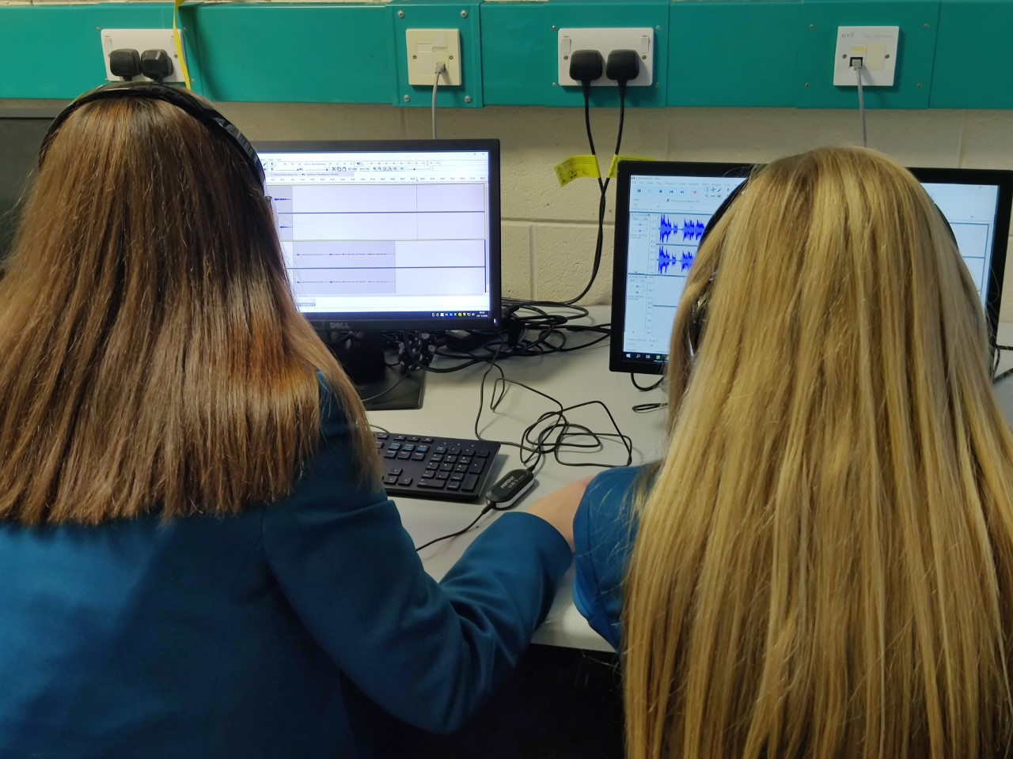
THE icT/Digital TECHNOLOGY OPTION FOR SIXTH FORM
Ict DEPARTMENT January 2022
Press F5 for automatic presentation and audio commentary

Slide 2
Why study ict?
A qualification in ICT/Digital Technology will give you excellent ICT knowledge, sharp analytical skills and excellent problem-solving skills. This means that when it comes to potential careers, the world is pretty much your oyster.
No matter what career you are thinking of a qualification in Digital Technology is a major asset. IT career options include:
Web Designer
Systems Analyst
Graphics Designer
Video Games Developer
Warehouse Management/Stock Management
Apps Developer
User Experience Developer
Media (Broadcast Engineer, Multimedia Broadcaster, Sound Technician, Video Editor)
Financial services (Credit Analyst, Commodity Broker, Financial Risk Analyst).
Cybersecurity
Any job that requires online communication, record-keeping and promoting social media
How’s that for choice? In a challenging economy where jobs are hard to come by computer skills are a real asset that open many career paths and allow you to access jobs that earn well above the average salary!

Slide 3
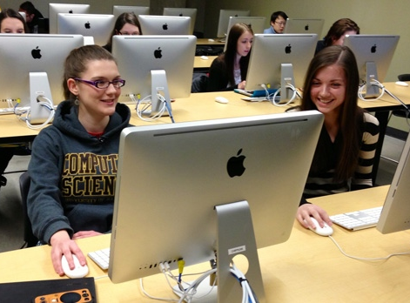
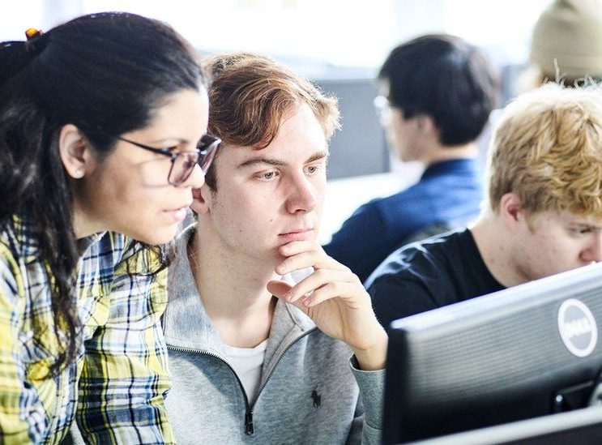
STUDYING COMPUTERS IS NOT JUST FOR BOYS!
There is a false perception that ICT/Digital Technology is a subject more suited toward male students – this could not be further from the truth!
Recently one of our female students achieved an A* in her Digital Technology GCSE course and all 6 female students in last year’s Year 14 A Level class achieved a Distinction* overall (which is the highest grade achievable)!
As a department we are very proud of our results at GCSE and A Level – both girls and boys have performed brilliantly and enjoyed the courses very much!
The number of women taking places on computer courses has more than doubled in recent years. Only 22% of students on computer-related University courses were female just 6 years ago – that number has grown now to over 45% in many cases!

Slide 4
COURSE AIM
Cambridge Technicals in IT allows students to gain an insight into IT with a wide range of units that provide students with practical and project-based opportunities to develop knowledge and skills.
To give student full UCAS points the equivalent of one full A Level
Develop a wide range of computer skills
Develop problem-solving and thinking skills
Acquire modern computing skills desirable to a broad range of careers

Slide 5
OCR CAMBRIDGE TECHNICAL ICT
What you will be studying:
YEAR 13
Unit 1: Communication and Employability Skills
Unit 2: Information Systems
Unit 19: Spreadsheet Modelling
YEAR 14
Unit 23: Database Design
Unit 27: Digital Graphics
Unit 43: Understanding social media for business
Method of study:
100% Coursework

Slide 6
Progression opportunities
University courses (full UCAS points equivalent to an A Level
Employment opportunities involving need for computing skills
Business-based Apprenticeships

Slide 7
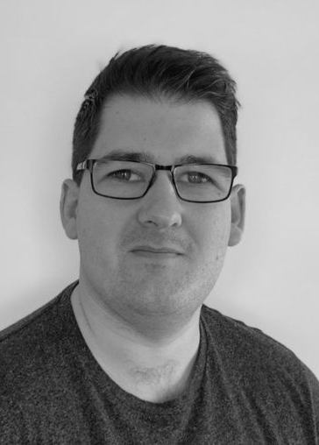
PAST ICT/DIGITAL TECHNOLOGY PUPIL SUCCESSES
Dominic Holmes completed his GCSEs and 6th form here at North Coast Integrated College. He loved studying ICT and it was among his favourite subjects.
He went on to study Computing with Game Development at Ulster University where he graduated with a first-class Honours degree. He was encouraged to pursue further education and applied for a PhD at Ulster University which focused on how to apply computer technology to healthcare, particularly for the rehabilitation of people who have suffered a stroke. He completed his PhD in 2018 and continues today to conduct research for Ulster University related to healthcare technologies. From his research, he co-founded and is currently CTO of eXRT Intelligent Healthcare, which delivers healthcare products to improve patient mobility and healthcare practices. eXRt’s current product provides stroke patients with a fun way of performing their physiotherapy at home using virtual reality devices; their physiotherapist can remotely monitor their progress from a mobile app in real-time.
This product has been used in research with the NHS, Italian and Norwegian hospitals , with more plans to expand across UK/Europe. The company is still in start-up phase and is involved in several investor funding events such as INVENT2020 by Catalyst in Belfast. It was just announced recently that the company is a finalist in the competition.
One of the company employees is also a past pupil of NCIC student, Roisin Holmes who graduated from Ulster University with a first-class Honours degree in Computing. She has been working on the development of the product and plays an important role in social media and marketing of the product.

Slide 8
Any further questions?
Please feel free to send an email message to Mrs Shaw rshaw387@c2ken.net, Mr Moran gmoran263@c2ken.net or Mrs Tasker dtasker929@c2ken.net with any questions you have about your options and the Digital Technology course. Or feel free to call in to talk to these teachers who will be delighted to hear from you

