Slide 1
GCSE Options
Hospitality

Slide 2
GCSE Hospitality – why choose it?
GCSE Hospitality is a two year course which allows you to develop a broad knowledge and understanding of the hospitality industry. In particular, you learn about the operation of the hospitality industry, products and services available, customer care, reception and accommodation and basic food hygiene practices.
You will develop the core skills required for working in the hospitality industry and transferable skills that are important in working life. Students are encouraged to gain a work placement in the hospitality industry. If you love to cook, it’s the course for you!
This Photo by Unknown author is licensed under CC BY-NC.

Slide 3
Hospitality or OSQ Cuisine???
Hospitality
OSQ Cuisine
Exam at the end of the 2 years is worth 50%of the final grade.
More practical and no exam at the end of the course.

Slide 4
How am I assessed?
Content | Assessment | Weighting | When can I complete this?
Unit 1 The Hospitality Industry | 1 exam paper lasting 1 hour | 25% | Every Summer
Unit 2: Hospitality and the consumer | 1 exam paper lasting 1 hour | 25% | Every Summer
Unit 3: Food and Drink. | Students must complete: a portfolio of 3 tasks, which all have a practical outcome and a whole class function. | 50% | Every Summer

Slide 5
Careers linked to Hospitality
Head chef
Chef de patisserie
Waiter/waitress
Front office managers
Conference/ events managers
Account managers.
Accommodation manager
Concierge
Receptionist
Housekeeper
Maintenance manager
Home Economics teacher
Hotel manager
Porter
Maitre d

Slide 6
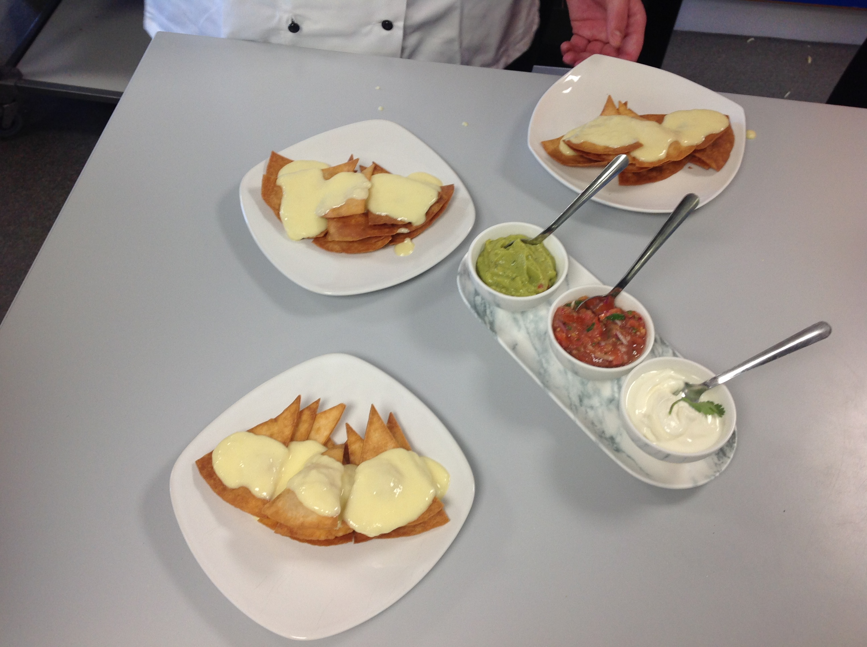
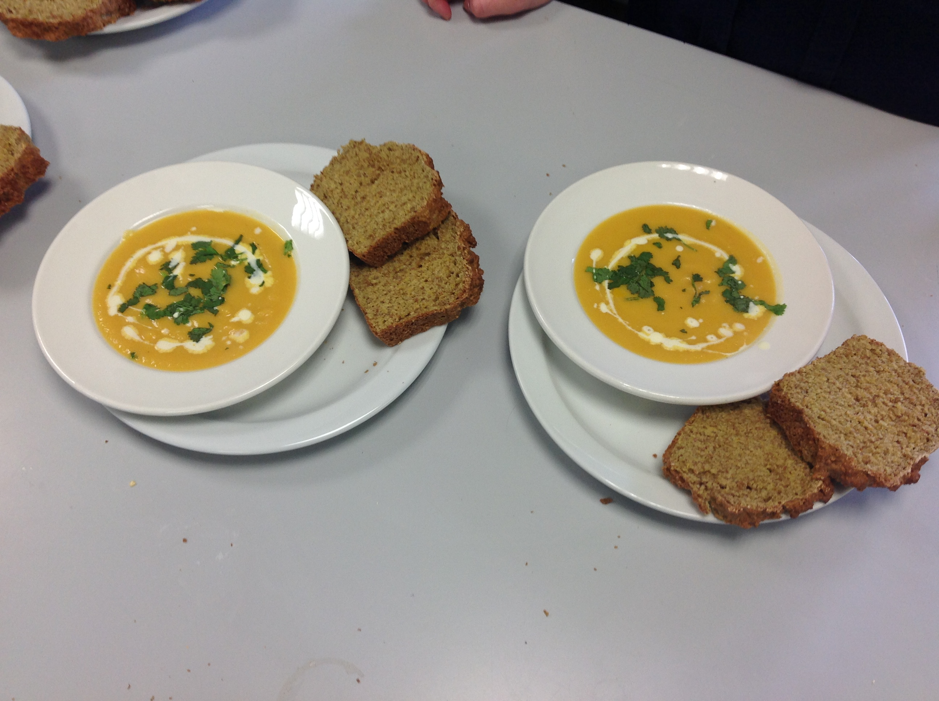
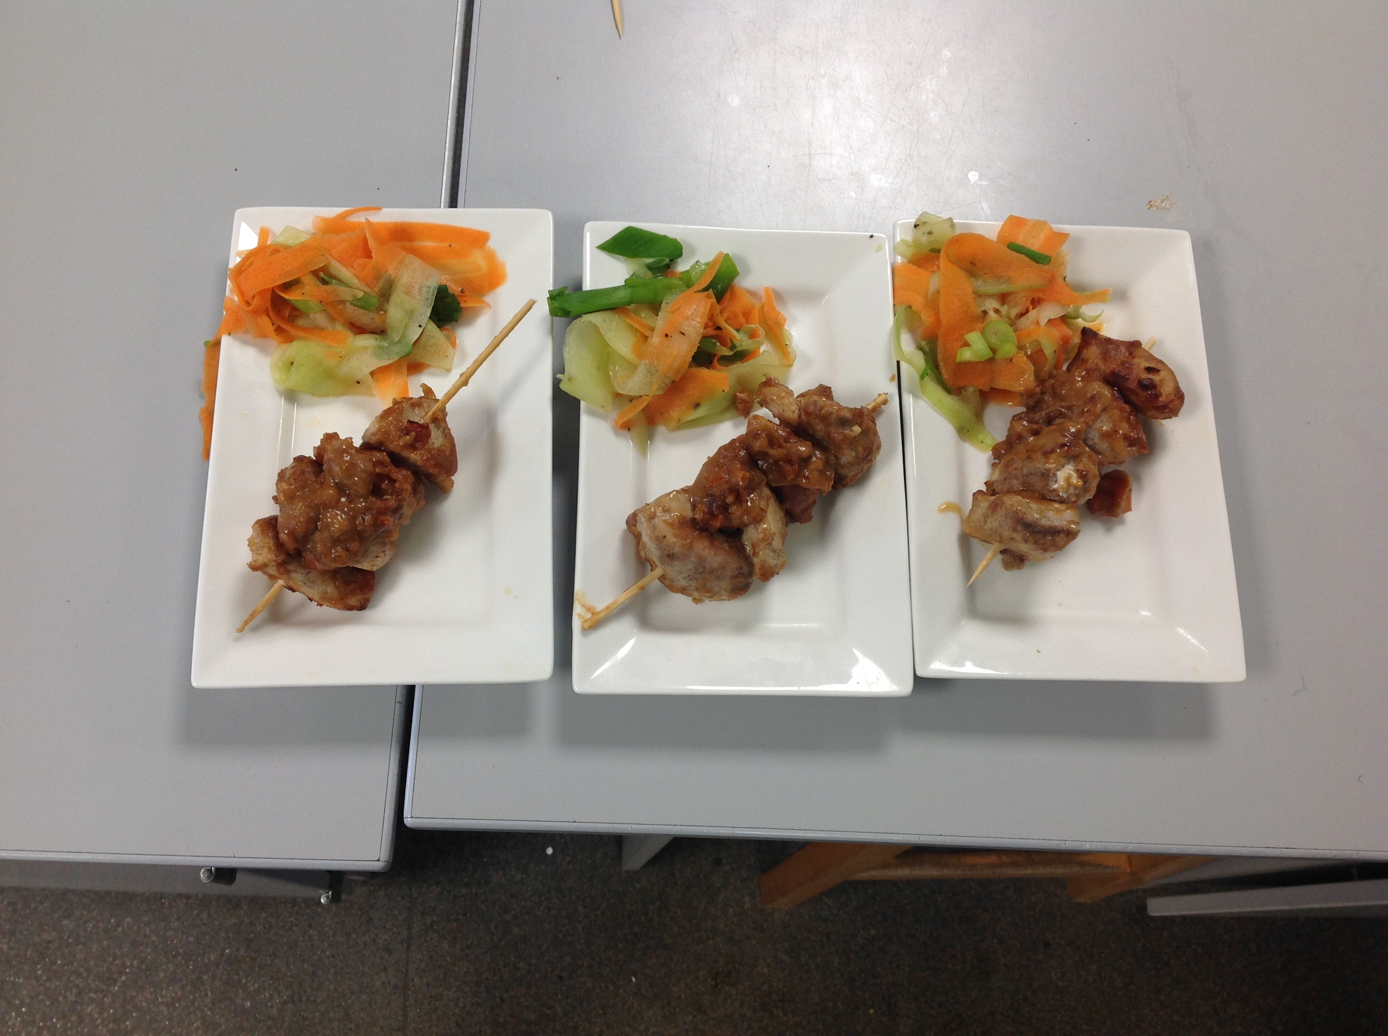
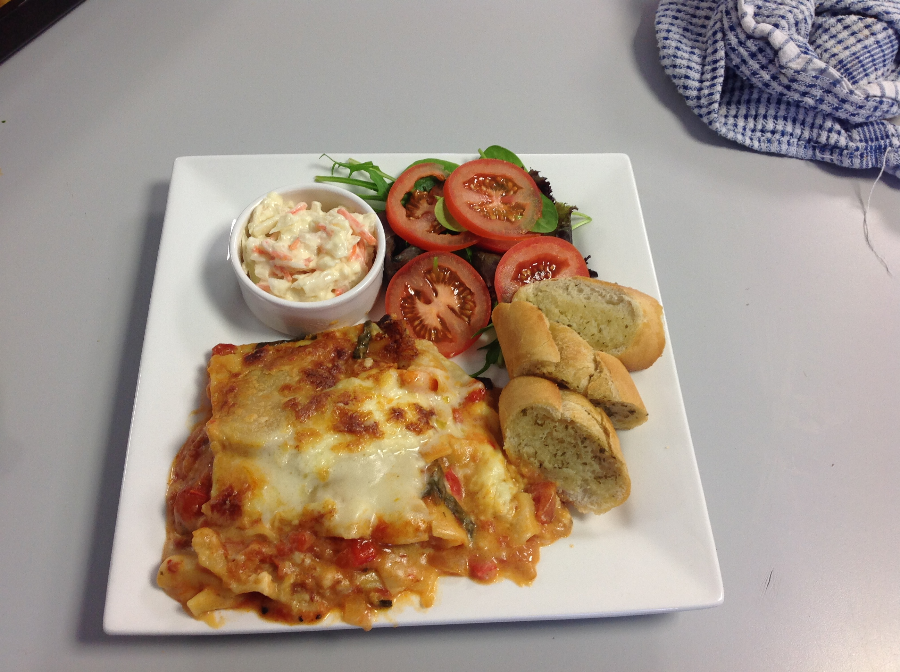
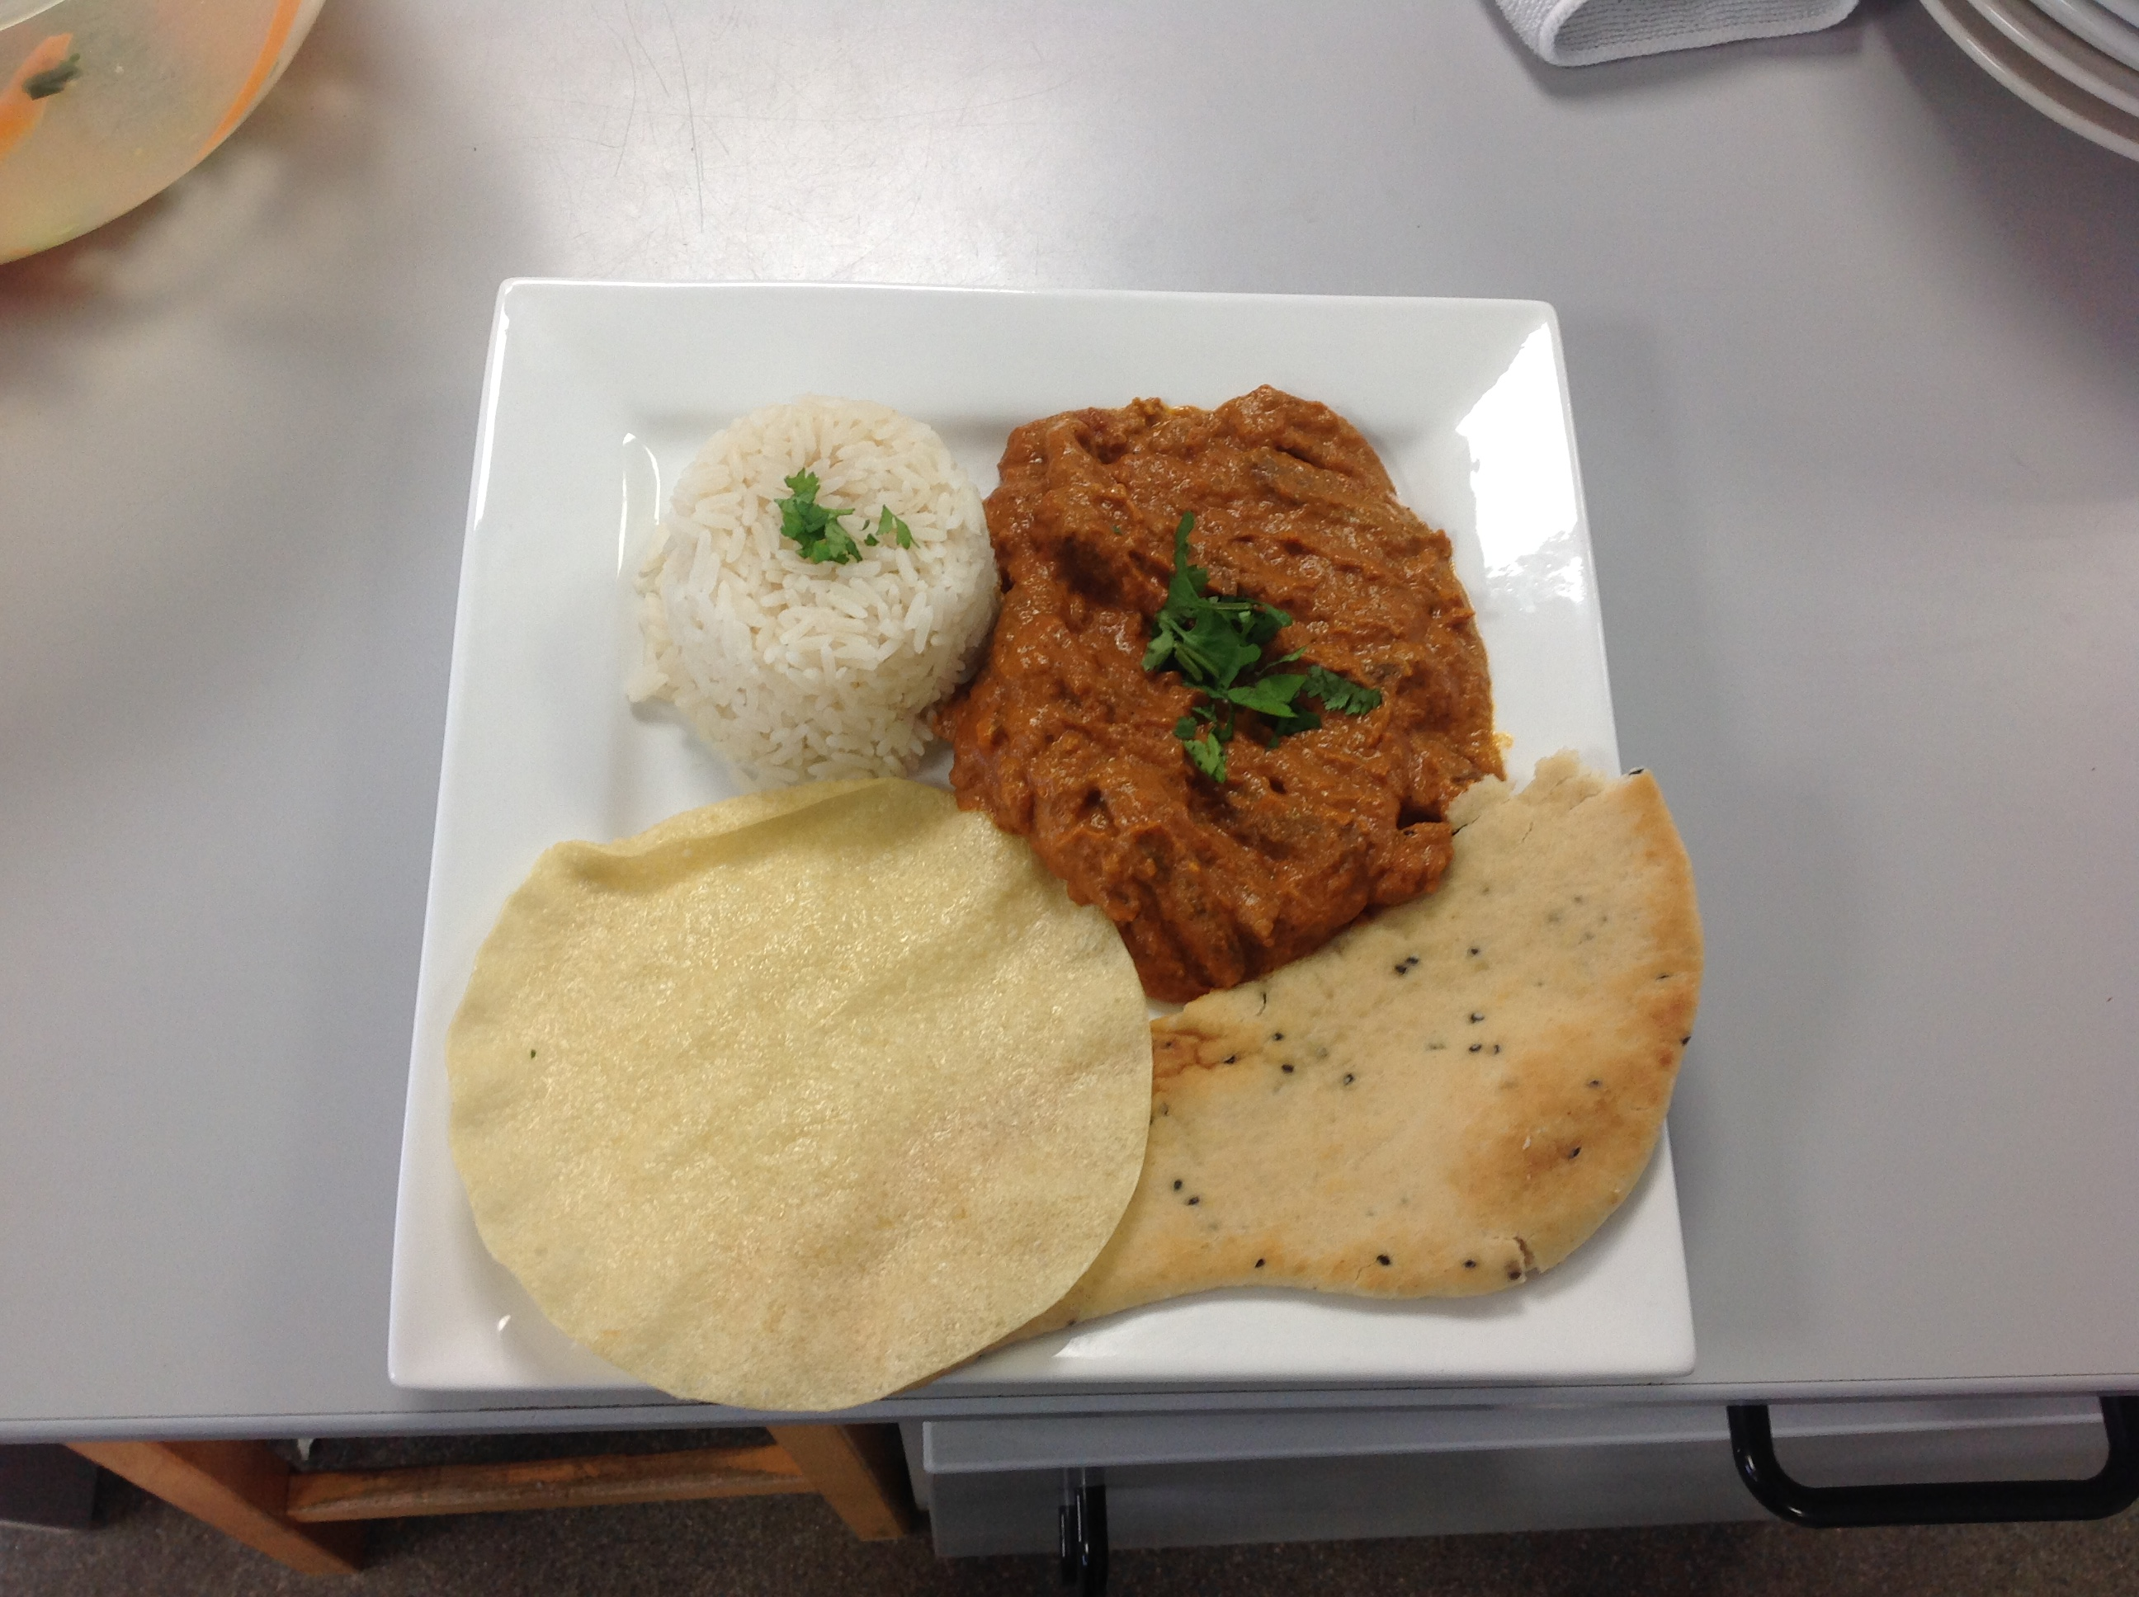
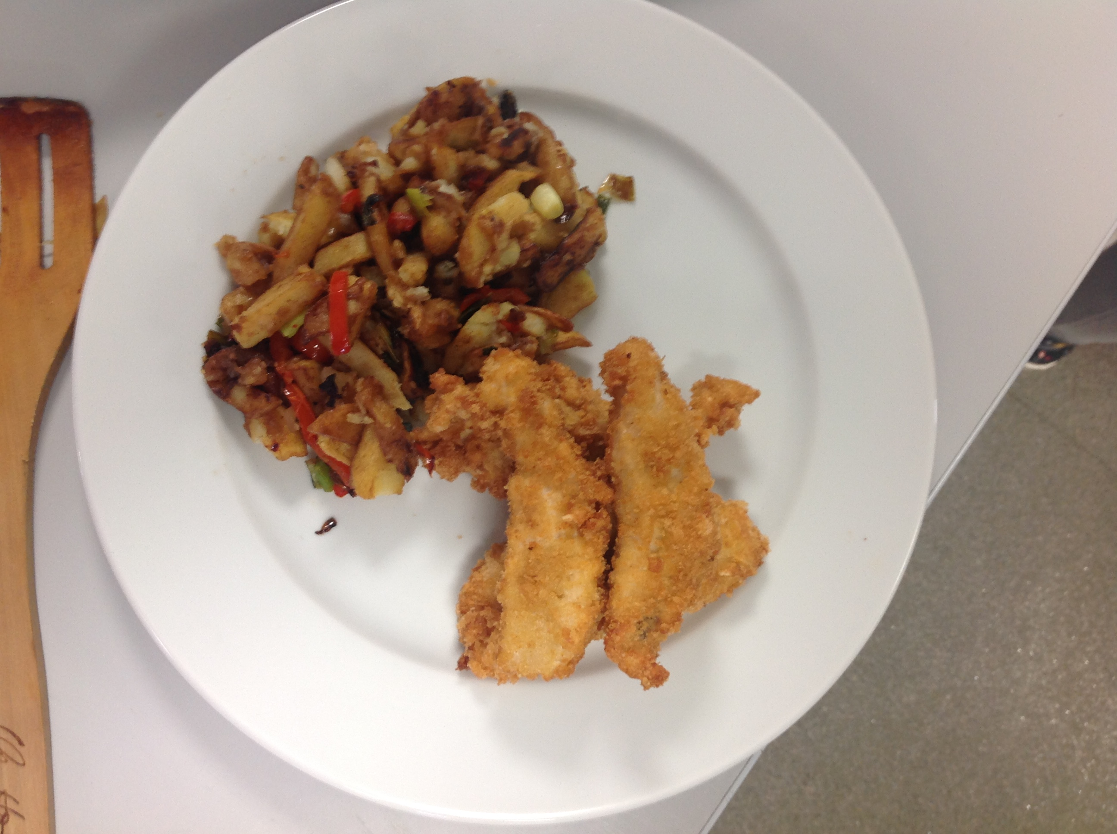
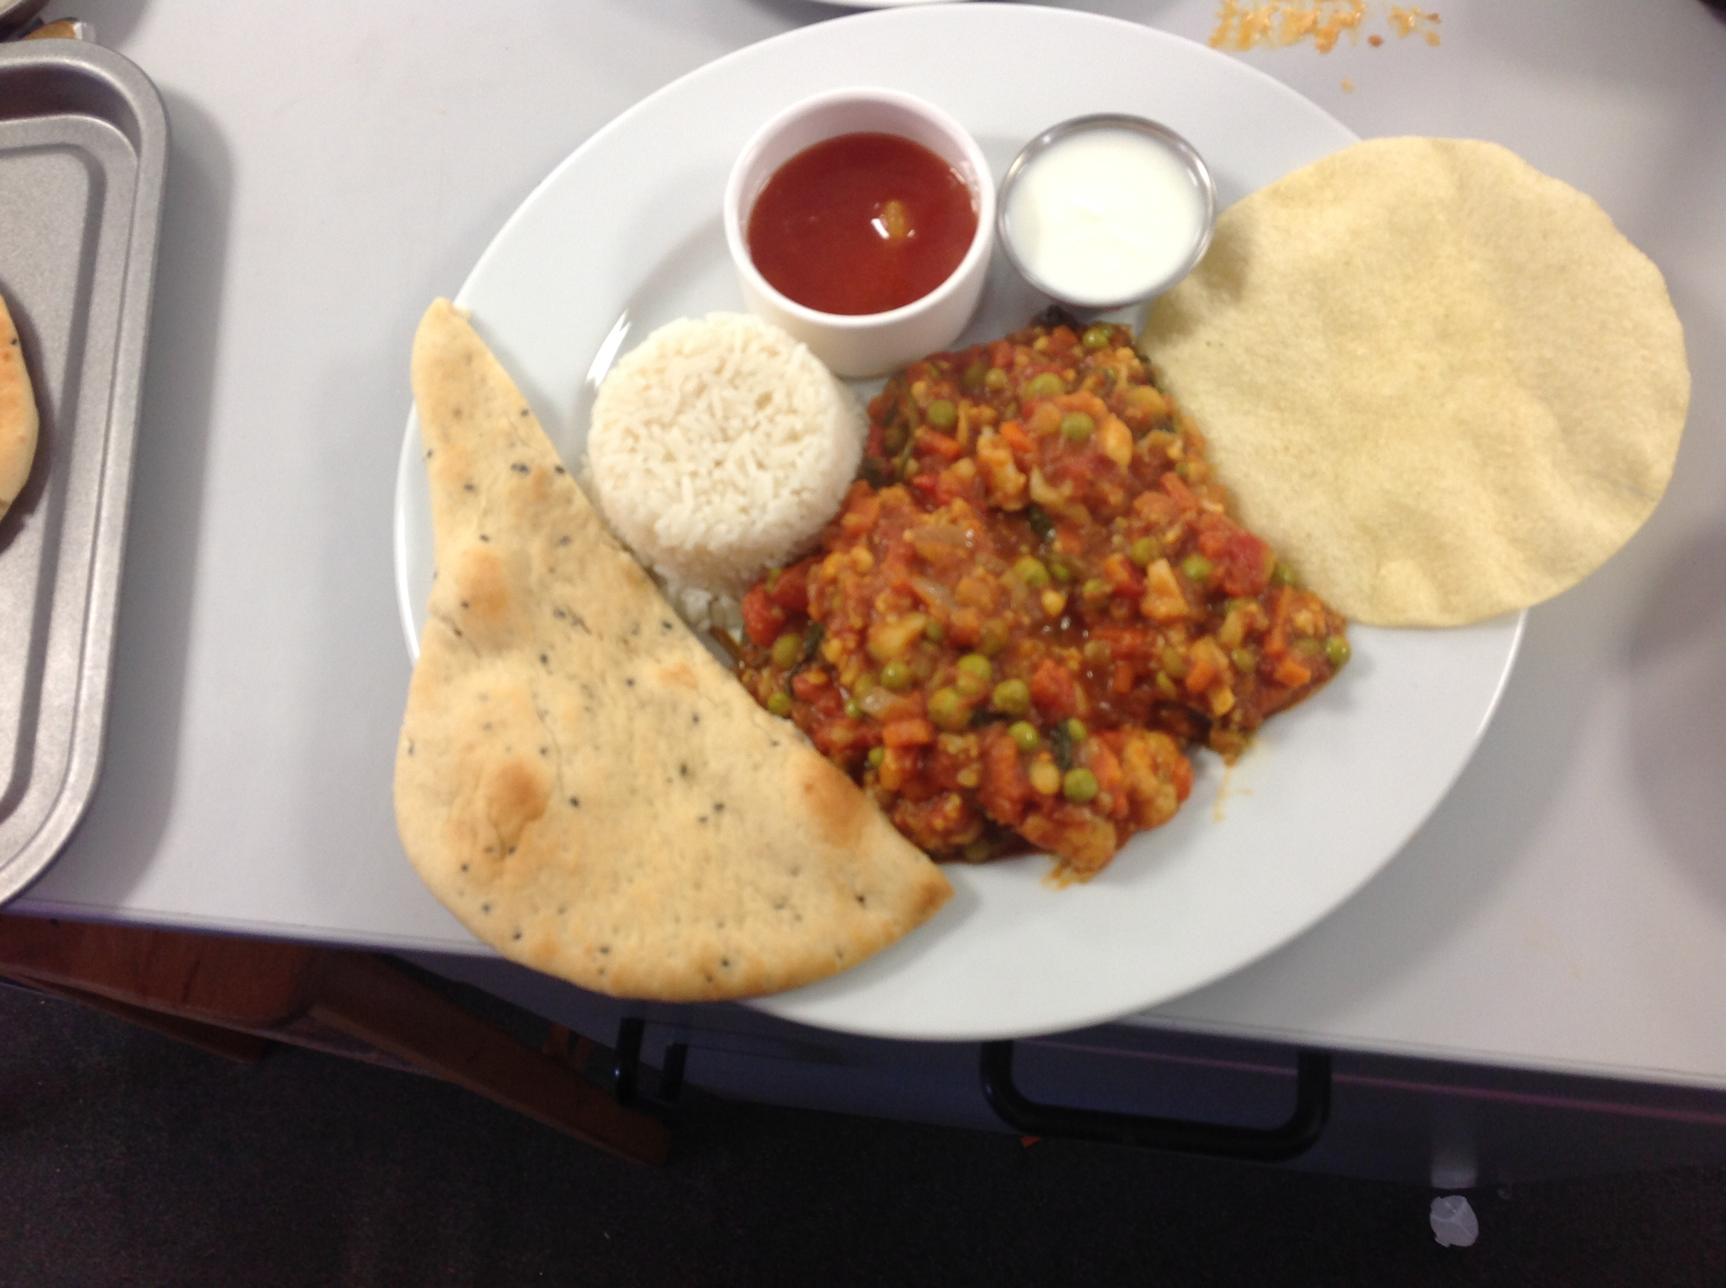
GCSE Hospitality Work

Slide 7
Further information
If you have any questions about the subjects discussed in this presentation, please email Ms Evans at:
levans326@c2ken.net
Or alternatively ring the college on 02870329026 and I can answer any questions you may have

Slide 8
Further information
If you have any questions about the subjects discussed in this presentation, please email Ms Evans at:
levans326@c2ken.net
Or alternatively ring the college on 02870329026 and I can answer any questions you may have

