Slide 1
OS Hair and Beauty

Slide 2
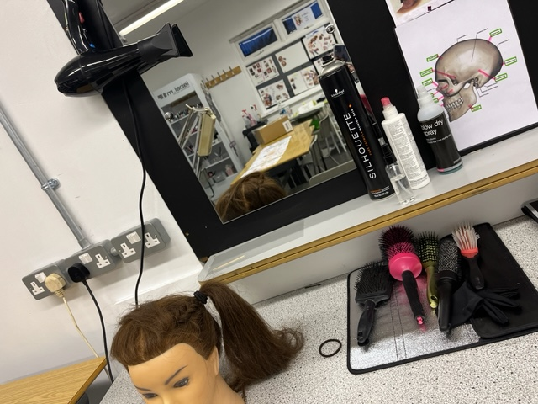
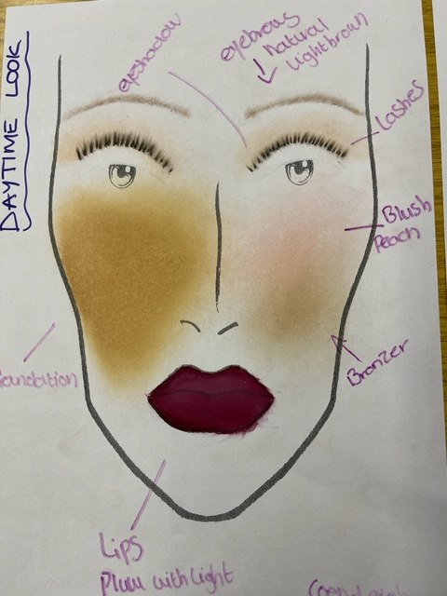
Two units are studied one in Yr 11 and one in Yr 12
Creative Blow drying
Total Beauty

Slide 3
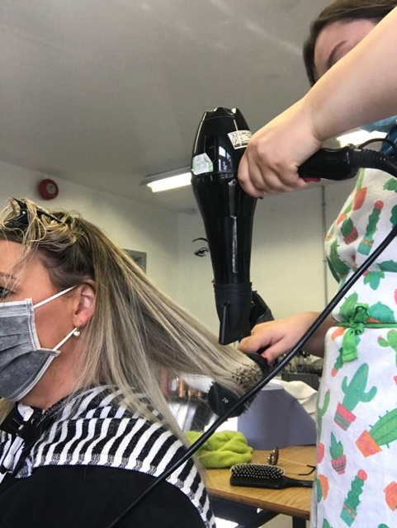
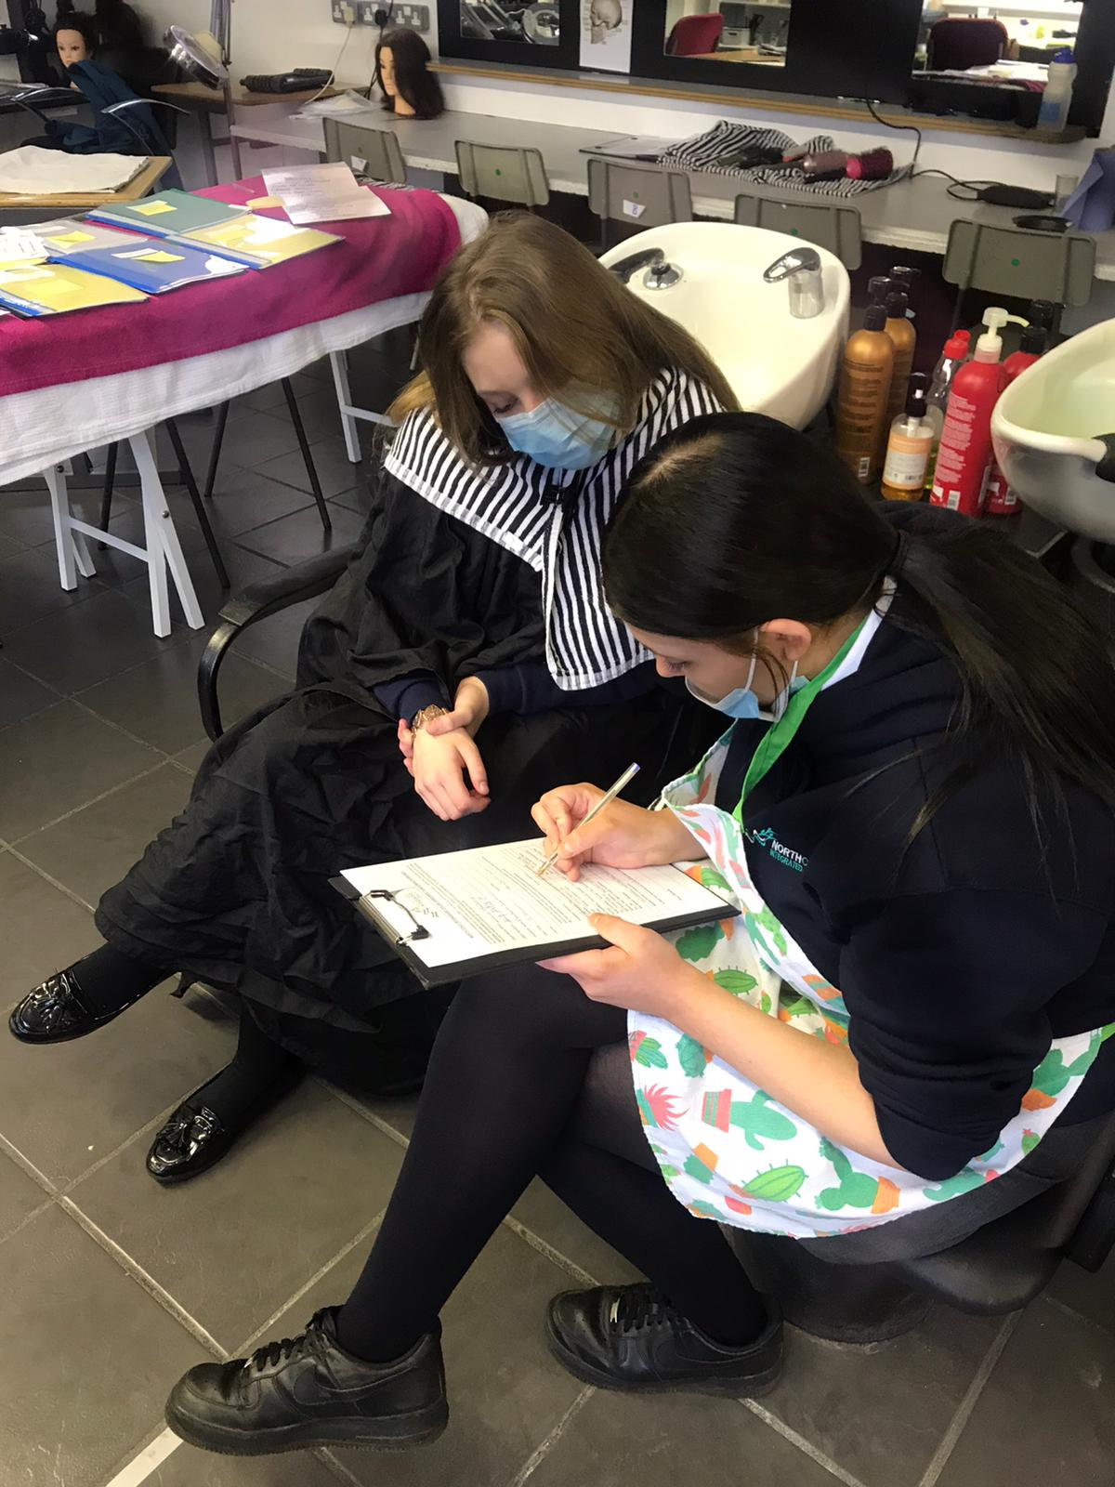
Creative Styling Using Blow-Drying Techniques
OS Design

Slide 4
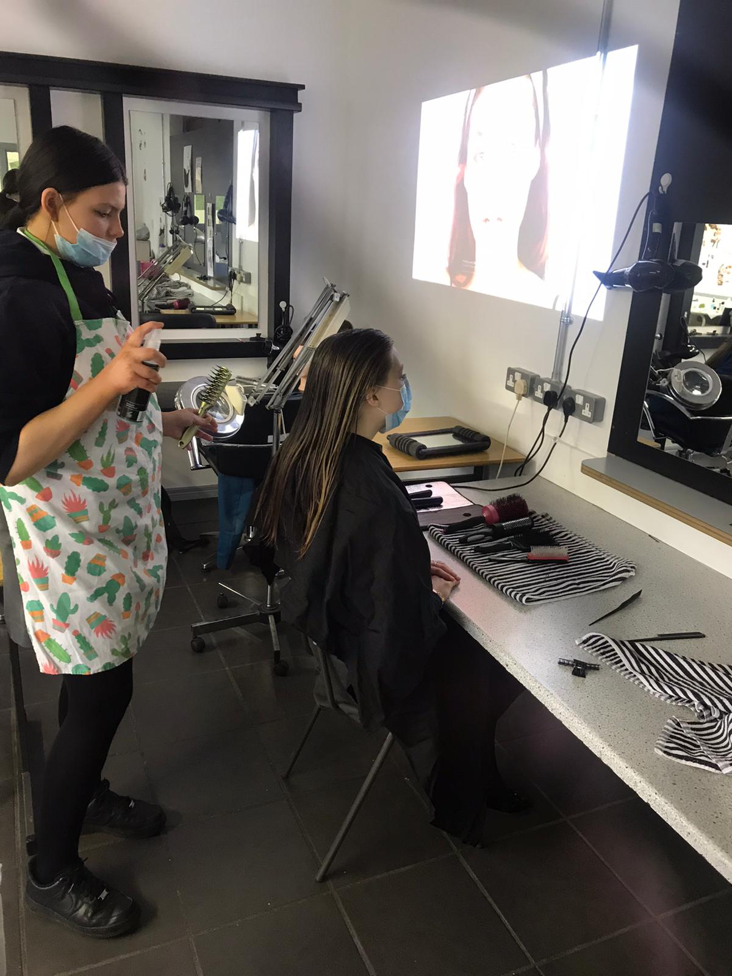
You will Learn about products suitable for different hair types and textures;
use a range of flat and round brushes to achieve different styles;
• learn about the different styling products and equipment and how they are used to achieve the style;
• be able to divide hair into sections to suit the size of the brush and style hair using the correct brush;
• know how the air flow and the temperature of the hand dryer is controlled throughout the blow-dry.

Slide 5
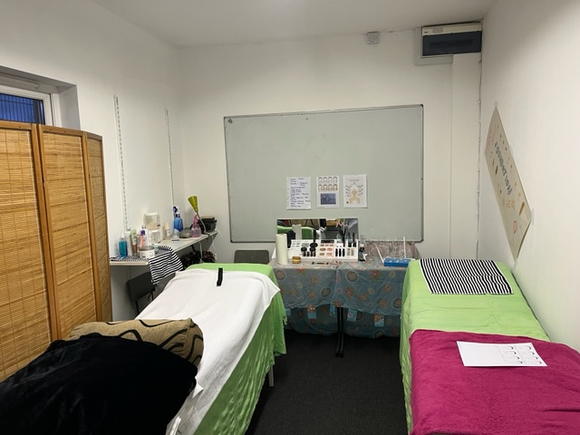
Total Beauty
You will learn about the role of the beauty therapist and career opportunities;
• skin tone and application of make-up;
• influences of hair fashion, design and the media;
• creating a beauty look for different occasions.

