Slide 1
BTEC Level 3 Applied Science

Slide 2
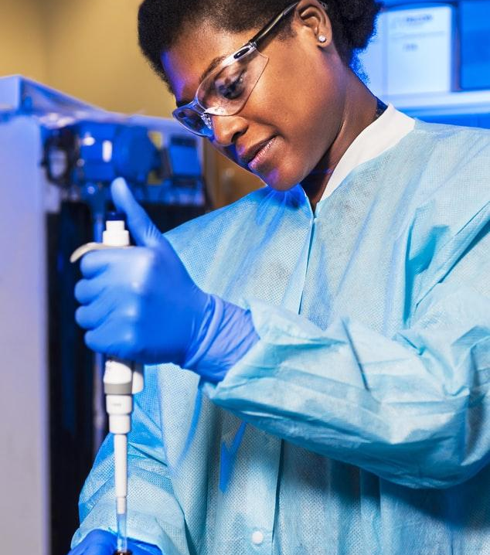
Why study Applied Science ?

Slide 3
Course aims
Applied Science will allow you to study how science is used in many different types of professions and industries. The focus of the course is how science is used and how scientists and others use science in their work. You will also learn how science contributes to our lifestyle and the environment in which we live.
The course is designed to allow you to spend time in the laboratory, working on the kind of practical projects that may be undertaken by employees working in science-based industries.
Entry Criteria
Students wishing to follow Edexcel BTEC Level 3 Applied Science must achieve a grade C in GCSE Single or Double Award Science or equivalent and a C in Mathematics.

Slide 4
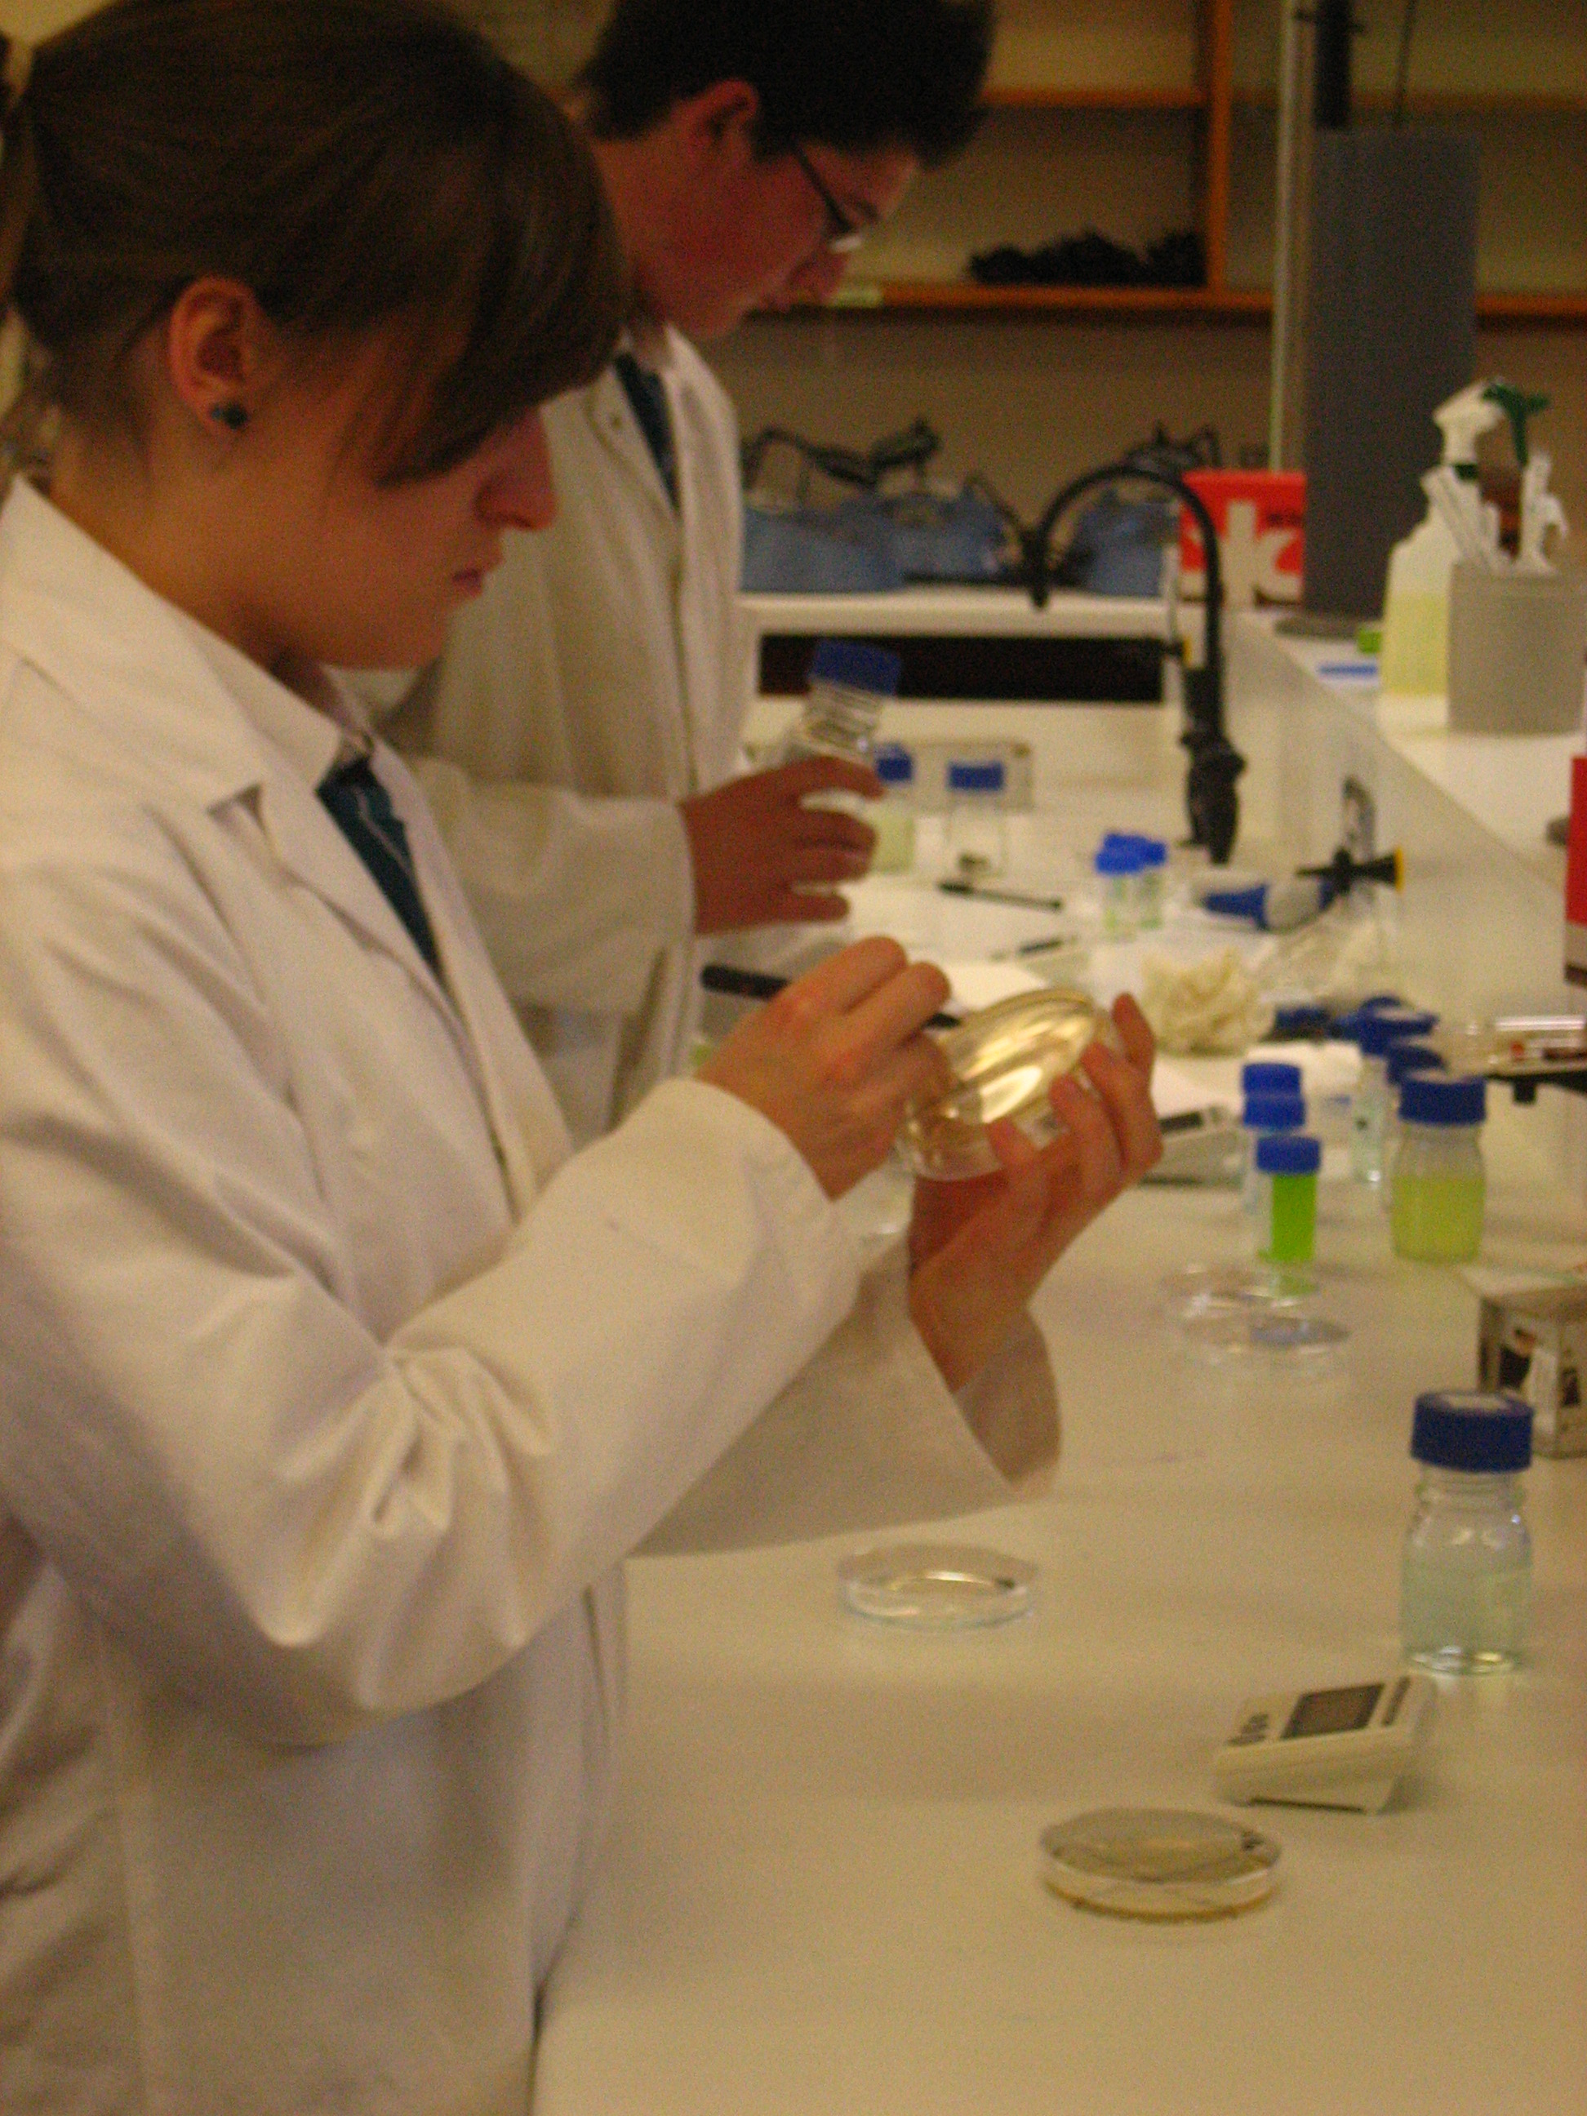
Course Content

Slide 5
Qualifications
BTEC Level 3 National Extended Certificate in Applied Science is equivalent to ONE A Level and comprises of 4 units to be completed in two years.
BTEC Level 3 National Diploma in Applied Science is equivalent to TWO A Levels and comprises of 8 units to be completed in two years.

Slide 6
Extended Certificate in Applied Science
1
Principles and Applications of Science I
External examination - 25% of BTEC
2
Practical Scientific
procedures and techniques
Internal assessment (coursework) – 25% of BTEC
3
External examination – 33.3% of BTEC
Science investigation
skills
8
Internal assessment (coursework) – 16.7% of BTEC
Physiology of human
Body systems

Slide 7
Diploma in Applied Science – Unit 1,2,3 and 8 plus the following units
4
Laboratory techniques
Internal assessment - 25% of BTEC
5
Principles and applications
of Science II
External examination – 33.3% of BTEC
6
Internal assessment – 25% of BTEC
Investigative project
10
Internal assessment (coursework) – 16.7% of BTEC
Biological molecules

Slide 8
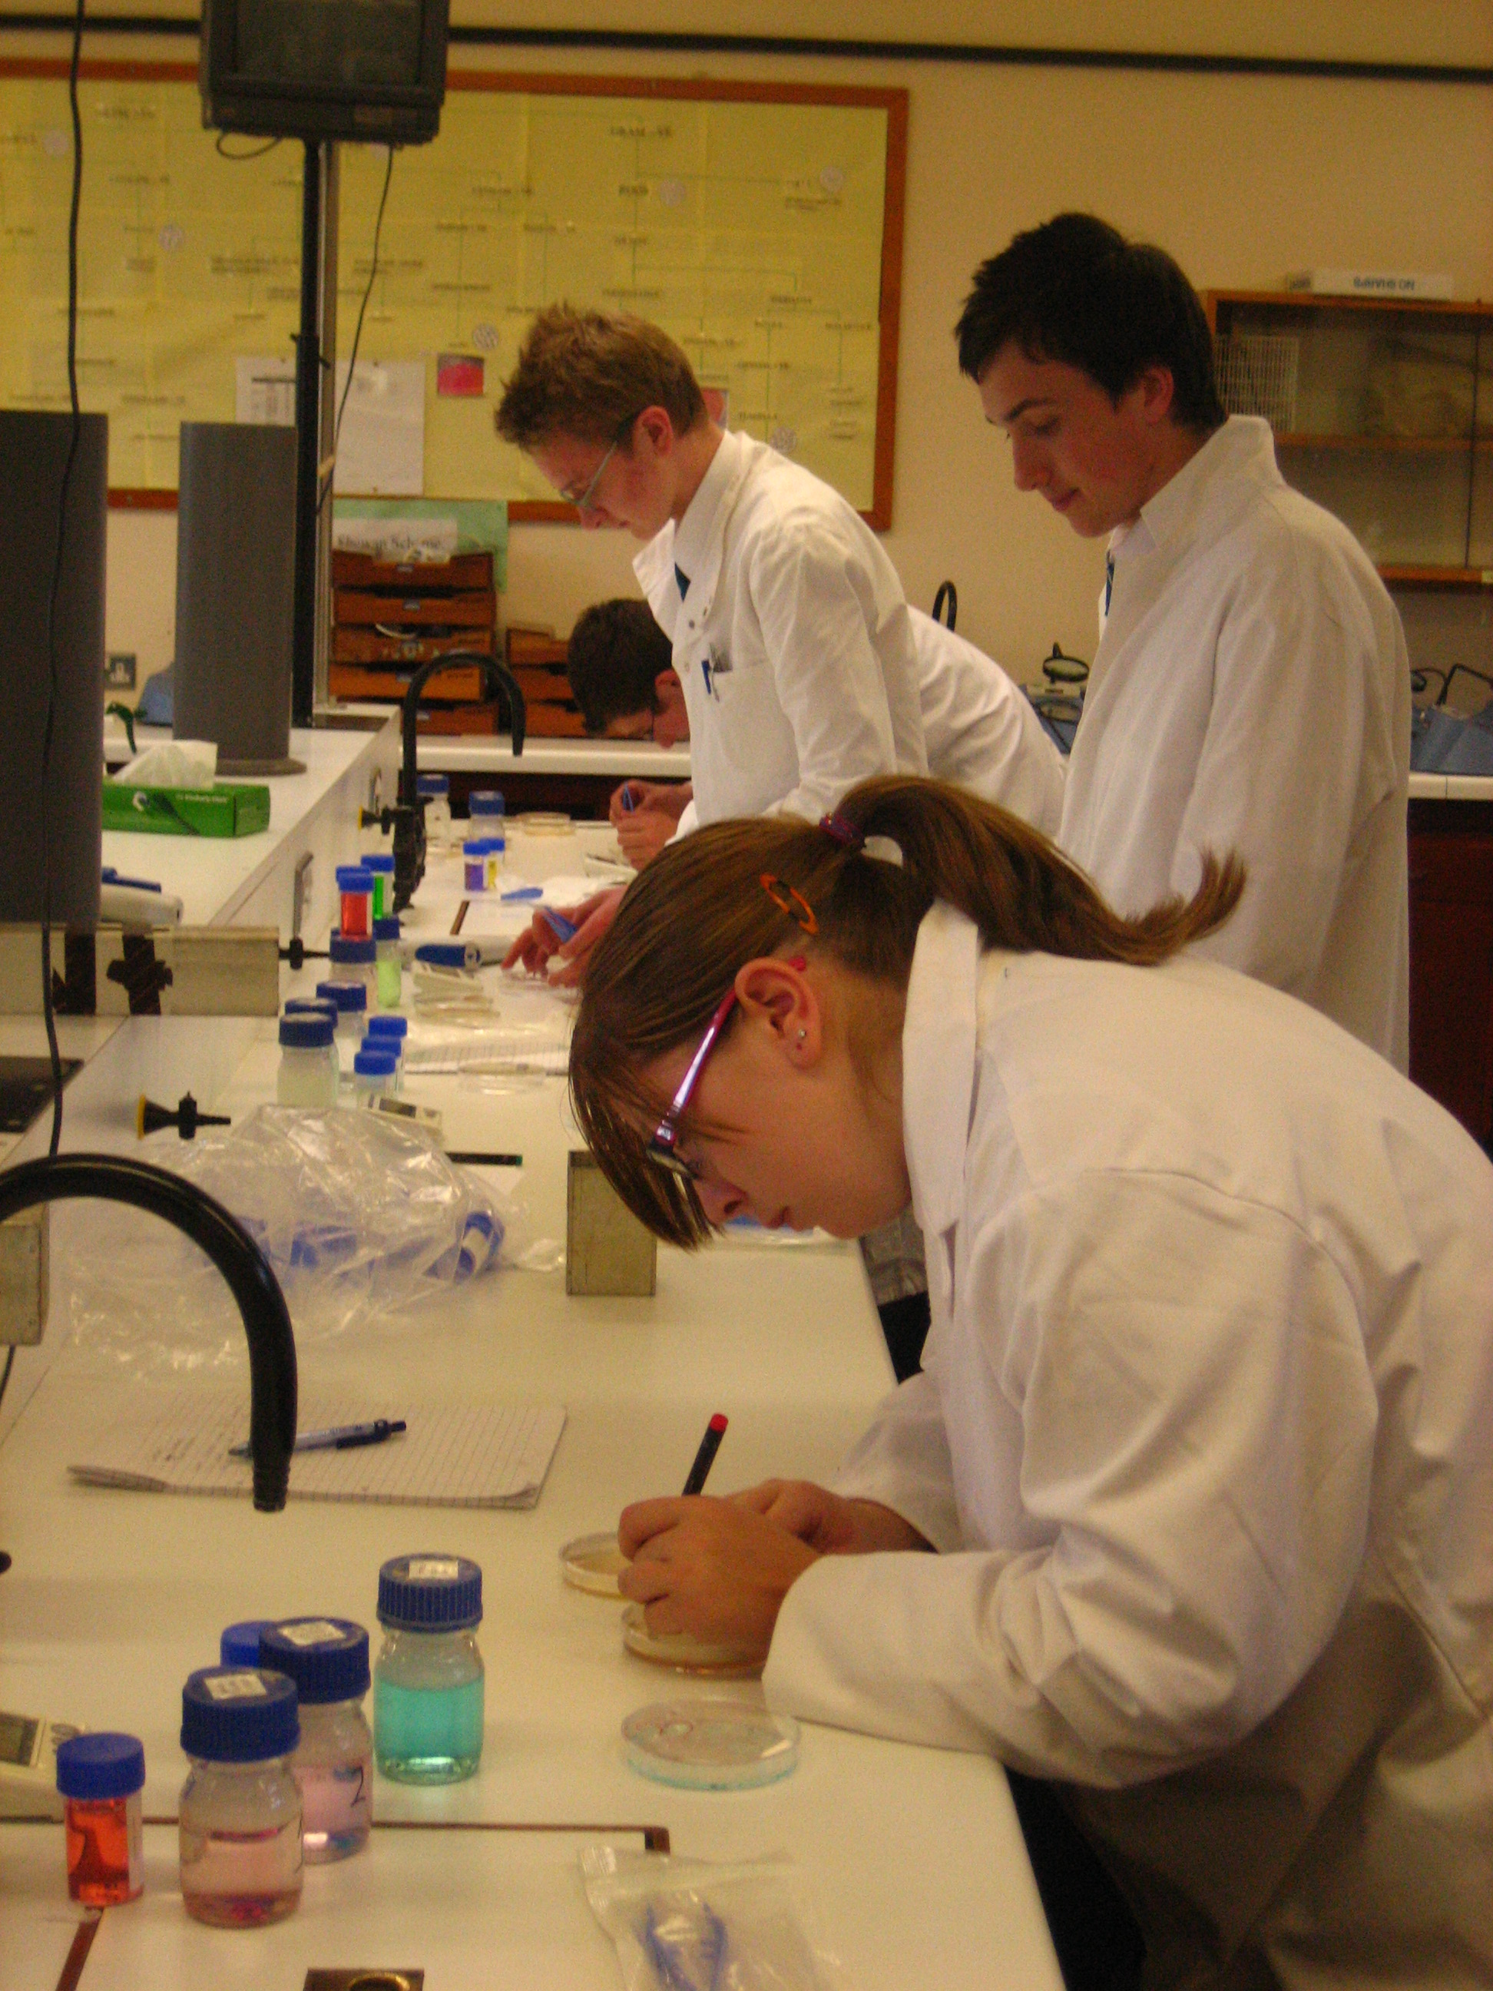
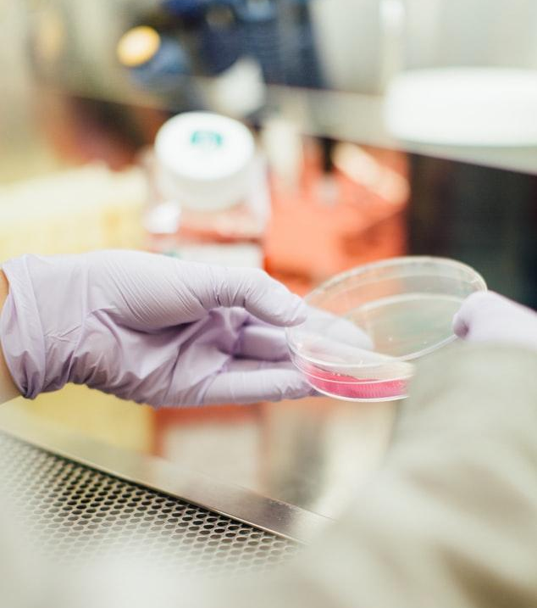

Slide 9
Award Grade
Distinction* 56 UCAS points
Distinction 48 UCAS points
Merit 32 UCAS points
Pass 16 UCAS points

Slide 10
Careers
Both qualifications are currently acceptable as Science ‘A’ Levels on courses that do not specifically require ‘A’ level Science.

Slide 12
Any Questions?
Please feel free to send an email to Mrs Brown vbrown989@c2ken.net
with any questions you have about BTEC Applied Science or by phone at school.

