Slide 1
North Coast Integrated College
Technology & Design Department

Slide 2
Occupational Studies – Technology & Innovation
This subject is useful for those interested in a career in joinery, or other areas that involve working with your hands as many of the practical skills (measuring, marking out etc.) are transferable.
It is also useful for those interested in Architecture or drafting (technical drawing) due to the varied nature of the two units involved.
The two units studied are Bench Joinery and AutoCAD

Slide 3
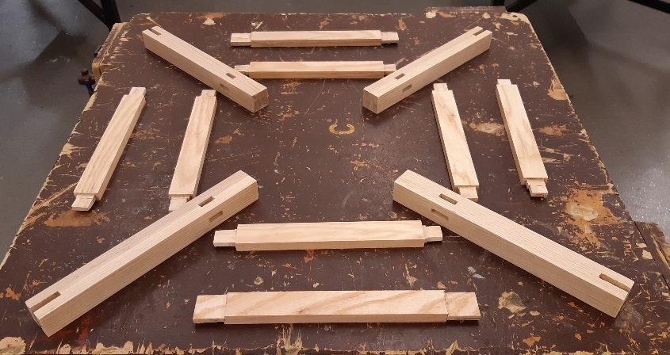
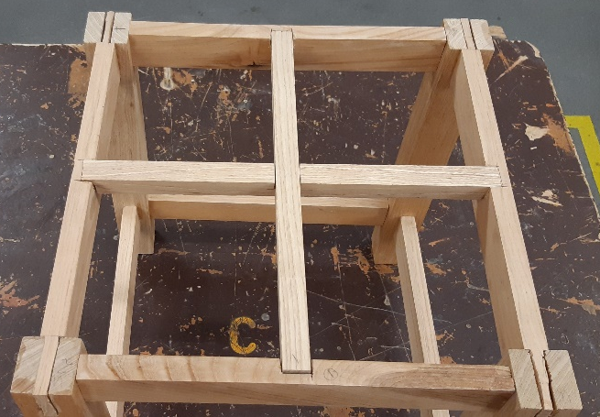
1. Bench Joinery (50% of overall subject mark)
This unit involves the manufacture of a plant table using traditional woodworking techniques and tools. The table incorporates mortise & tenon, bridle, halving and cross-halving joints.

Slide 4
2. Computer Aided Drawing (50% of overall subject mark).
In this unit the students copy and amend a range of drawings using AutoCAD software. As this unit is covered in Yr12, it is very convenient for those who also choose GCSE Construction as they already have developed the necessary skills.

Slide 5
Each OS unit is broken down into three sections:
AO1 Knowledge & Understanding (20% of unit)
This is a written section which includes questions / research testing the students’ knowledge of Tools/Materials, Health & Safety and Careers within the subject area.
AO2 Practical (60% of unit)
This section is the practical manufacture / completion of drawings in the subject area.
AO3 Evaluation (20% of unit)
In this section, students must evaluate each stage of their practical work. They should be able to identify areas of difficulty and how these difficulties were resolved.
A diary is also required to be kept over the course of each unit.

Slide 6
Qualities required for success in OS Technology & Innovation
Candidates for OS Technology & Innovation should have a genuine interest and reasonable skills in practical work. They should also be able to pay attention to detail and be able to work on their own initiative after being given instruction.
The ability to think critically and to identify their own strengths and weaknesses is important for evaluation work.
As all the work for this subject is completed in school under controlled conditions, good attendance is crucial for success.

