Slide 1
Nail Art and Skincare
Occupational Business Studies

Slide 2
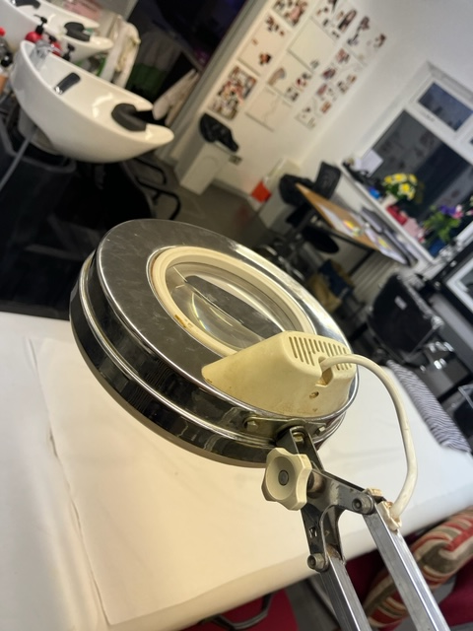
Skincare
• analysis of skin types and conditions;
• carrying out client consultations to identify appropriate treatment plans;
• application of facial skincare products in a safe and professional manner;
• giving aftercare advice to clients and obtaining client feedback.

Slide 3
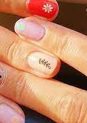
Manicure and Nail Art
•learn about the different skin types and and plan manicures and nail art treatment;
• study clients’ nails through nail analysis and oral questioning techniques;
• identify types of products and nail designs that are suitable for various nail types;
• analyse all evidence and record a treatment plan to meet the client’s nail care needs.

Slide 4
