Slide 1
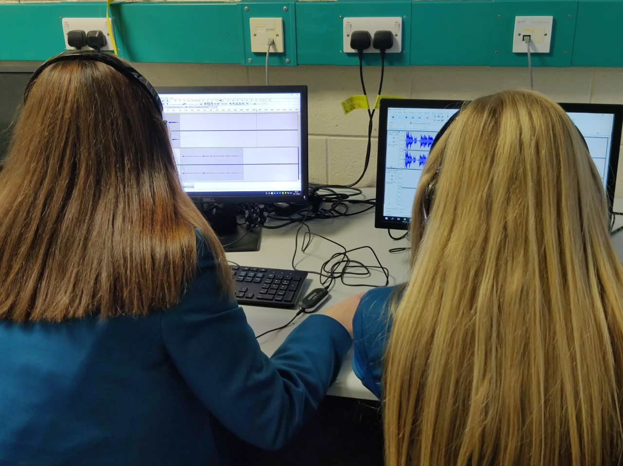
THE icT/Digital TECHNOLOGY OPTION FOR YEAR 10S
Ict DEPARTMENT January 2022
Press F5 for automatic presentation
and audio commentary

Slide 2
Why study digital technology/ict?
A qualification in ICT/Digital Technology will give you excellent ICT knowledge, sharp analytical skills and excellent problem-solving skills. This means that when it comes to potential careers, the world is pretty much your oyster.
No matter what career you are thinking of a qualification in Digital Technology is a major asset. IT career options include:
Web Designer
Systems Analyst
Graphics Designer
Video Games Developer
Warehouse Management/Stock Management
Apps Developer
User Experience Developer
Media (Broadcast Engineer, Multimedia Broadcaster, Sound Technician, Video Editor)
Financial services (Credit Analyst, Commodity Broker, Financial Risk Analyst).
Cybersecurity
Any job that requires online communication, record-keeping and promoting social media
How’s that for choice? In a challenging economy where jobs are hard to come by computer skills are a real asset that open many career paths and allow you to access jobs that earn well above the average salary!

Slide 3
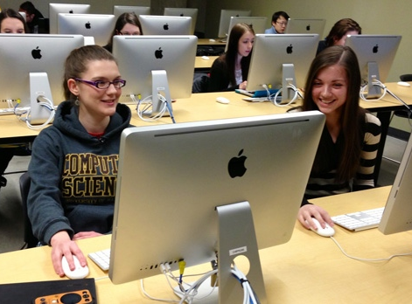
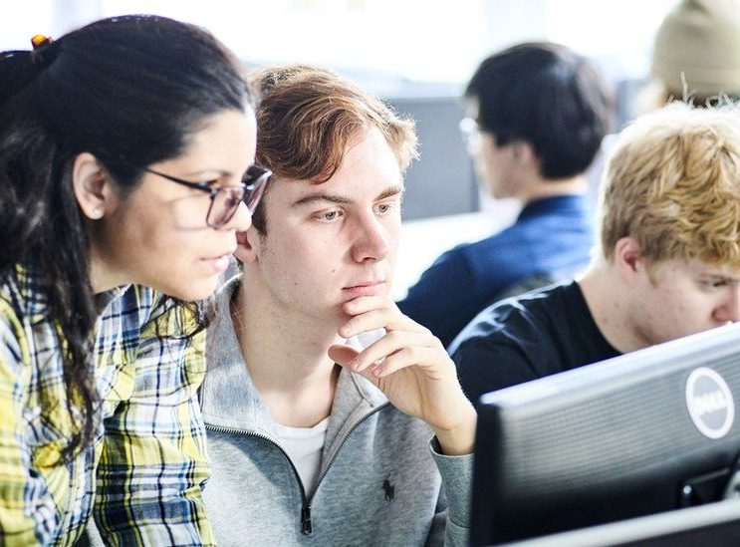
STUDYING COMPUTERS IS NOT JUST FOR BOYS!
There is a false perception that ICT/Digital Technology is a subject more suited toward male students – this could not be further from the truth!
Recently one of our female students achieved an A* in her Digital Technology GCSE course and all 6 female students in last year’s Year 14 A Level class achieved a Distinction* overall (which is the highest grade achievable)!
As a department we are very proud of our results at GCSE and A Level – both girls and boys have performed brilliantly and enjoyed the courses very much!
The number of women taking places on computer courses has more than doubled in recent years. Only 22% of students on computer-related University courses were female just 6 years ago – that number has grown now to over 45% in many cases!

Slide 4
COURSE AIM
Through studying GCSE in Digital Technology, students will become more independent and discerning users of Digital Technology. They will acquire and apply knowledge and understanding of digital technology in a range of contexts and they will have opportunities to obtain and apply creative and technical skills, knowledge and understanding of ICT in a range of contexts.
Students will develop and evaluate digital technology-based solutions to solve, problems; they will understand current and emerging technologies and the social/commercial impact of these technologies. Students will study the legal, social, economic, ethical and environmental impact of digital technology and they will recognise potential risks when using digital technology and develop safe, secure and responsible practice.

Slide 5
CCEA GCSE DIGITAL TECHNOLOGY
What you will be studying:
YEAR 11
Unit 1: Digital Technology – Exam (30% of qualification)
YEAR 12
Unit 2: Digital Authoring Concepts – Exam (40% of qualification)
Unit 3: Digital Authoring Practice – Controlled Assessment (30% of qualification)
Method of study:
70% Exam
30% Controlled Assessment

Slide 6
COURSE CONTENT - YEAR 11 Unit 1: Digital Technology – Exam
1 hour Written exam in the summer of year 11 on the following topics:
Digital Data
System Software
Database Applications
Spreadsheet Applications
Hardware and Network Technologies
Health and Safety
Cyberspace, Network Security and Data Transfer
Ethical, Legal and Environmental Impact
Digital Applications
Changes In Employment Opportunities
E-Commerce and Online Banking

Slide 7
COURSE CONTENT - YEAR 12 Unit 2: Digital authoring concepts – Exam
1 hour Written exam in the summer of year 12 on the following topics:
Designing Solutions
Digital Development Considerations
Multimedia Applications
Multimedia Authoring
Database Development
Testing and Drawing Up Test Plans
Evaluation of Digital Systems

Slide 8
COURSE CONTENT - YEAR 12 Unit 3: Digital authoring practice – in class coursework
You produce coursework in class on:
Designing a Database and Website
Building a Database and Website
Testing a Database and Website
Evaluating a Database and Website

Slide 9
Progression opportunities
This course prepares students for employment in the Digital Technology/ICT area. Examples are - Technician, Computer Programmer, ICT/Digital Technology Teacher, Software/Games Developer etc…
This course also:
Enables progression to further and higher education level and employment
Applies knowledge across a range of ICT/Digital Technology based scenarios
Develops valuable and transferable skills to prepare you for an ever changing and dynamic work place
Students can further their study in Sixth Form by completing:
OCR Cambridge Technicals in ICT

Slide 10
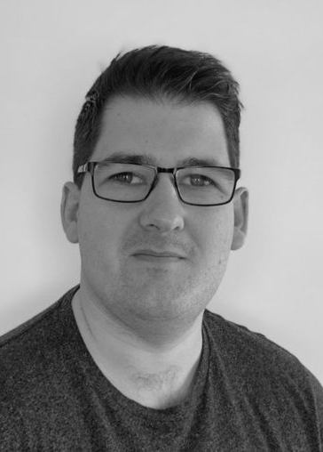
PAST ICT/DIGITAL TECHNOLOGY PUPIL SUCCESSES
Dominic Holmes completed his GCSEs and 6th form here at North Coast Integrated College. He loved studying ICT and it was among his favourite subjects.
He went on to study Computing with Game Development at Ulster University where he graduated with a first-class Honours degree. He was encouraged to pursue further education and applied for a PhD at Ulster University which focused on how to apply computer technology to healthcare, particularly for the rehabilitation of people who have suffered a stroke. He completed his PhD in 2018 and continues today to conduct research for Ulster University related to healthcare technologies. From his research, he co-founded and is currently CTO of eXRT Intelligent Healthcare, which delivers healthcare products to improve patient mobility and healthcare practices. eXRt’s current product provides stroke patients with a fun way of performing their physiotherapy at home using virtual reality devices; their physiotherapist can remotely monitor their progress from a mobile app in real-time.
This product has been used in research with the NHS, Italian and Norwegian hospitals , with more plans to expand across UK/Europe. The company is still in start-up phase and is involved in several investor funding events such as INVENT2020 by Catalyst in Belfast. It was just announced recently that the company is a finalist in the competition.
One of the company employees is also a past pupil of NCIC student, Roisin Holmes who graduated from Ulster University with a first-class Honours degree in Computing. She has been working on the development of the product and plays an important role in social media and marketing of the product.

Slide 11
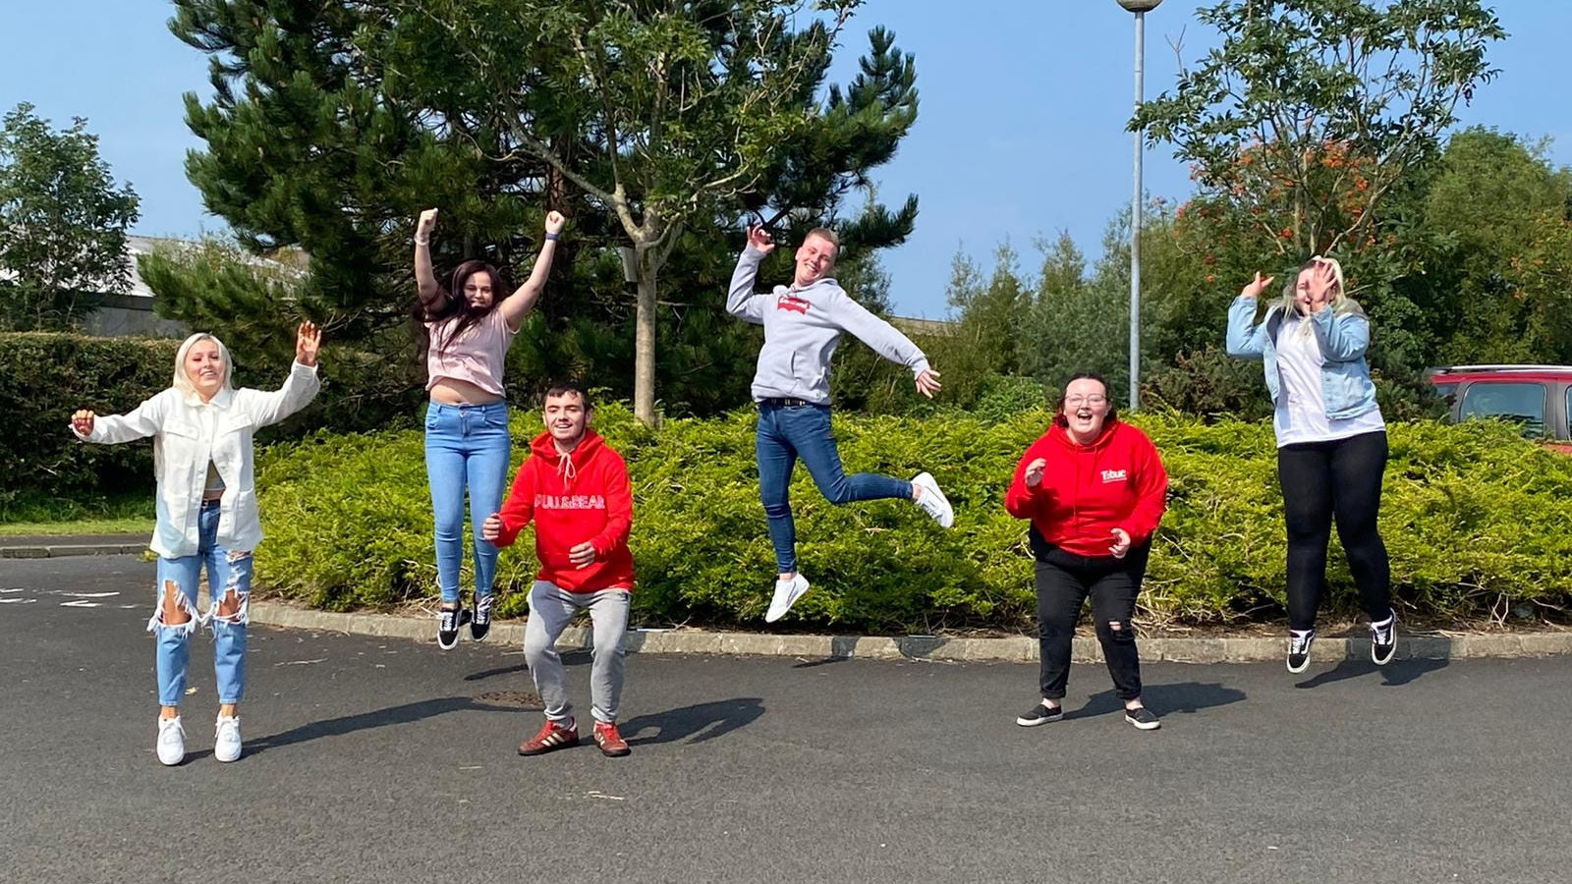
By choosing Digital Technology you are:
Choosing a modern qualification lots of employers want skills in
Working in a department with a great track record of exam success
Getting to work in modern and well-equipped computer labs
Opening up many career paths that lead to well-paid jobs
Studying a subject that is challenging, enjoying and fitting for the modern world

Slide 12
Any further questions?
Please feel free to send an email message to Mrs Shaw rshaw387@c2ken.net, Mr Moran gmoran263@c2ken.net or Mrs Tasker dtasker929@c2ken.net with any questions you have about your options and the Digital Technology course. Or feel free to call in to talk to these teachers who will be delighted to hear from you

