Slide 1
Year 10 Options
North Coast Integrated College

Slide 2
What type of qualification suits your learner?
Everyone has different strengths- some pupils are best at practical subjects; some pupils thrive under exam pressure!
Because we are an integrated school one of our strengths is that we have a wide range of qualifications and subjects to suit every learner.

Slide 3
Different Type of Qualifications
GCSE
BTECs
Occupational Studies

Slide 4
GCSEs
Some are 100% exam
Some subjects have controlled assessment; this is assessment that is completed in school.
Check what % of the qualification is controlled assessment. Some pupils do best in exams; some do best in controlled assessment.
Use your child's strengths to the best advantage.

Slide 5
BTECs
BTECs are called vocational qualifications. This means they are more career-focused qualifications grounded in the real world of work.
All BTECs are 25% exam and 75% continual controlled assessment completed over the 2 years.
BTECs are graded Distinction, Merit and Pass. In Year 12 (level 2)
Distinction* is equivalent to A*
Merit is equivalent to B
Pass is equivalent to C

Slide 6
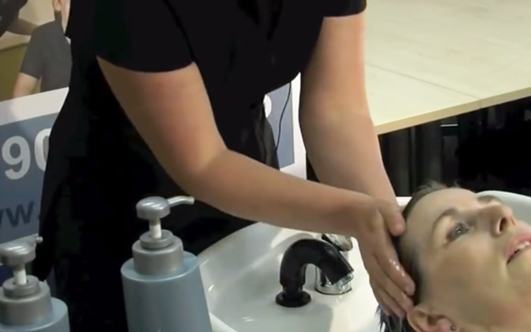
Occupational Studies
Occupational Studies allows learners to learn for work, through work and about work, it provides the potential for this learning to take place in out-of-school contexts such as in our farm or hairdressing saloon. This hands-on approach is ideal for those who prefer to develop their skills in a more practical environment. Grades are Distinction, Merit and Pass. The grade is obtained from 40% written controlled assessment and 60 % practical assessment.
This Photo by Unknown author is licensed under CC BY-SA-NC.

Slide 7
Smart Choices
Are you better at exams and cope well with exam pressure?...GCSEs.
BTECs continual assessment over the 2 years.
Occupational Studies have no formal exam and are more 'hands on'.

